Slide 1
Azure HD-Insight (Provisioning + Discovering Web UI)
arnaud.nauwynck@gmail.com
Esilv 2024

Slide 2
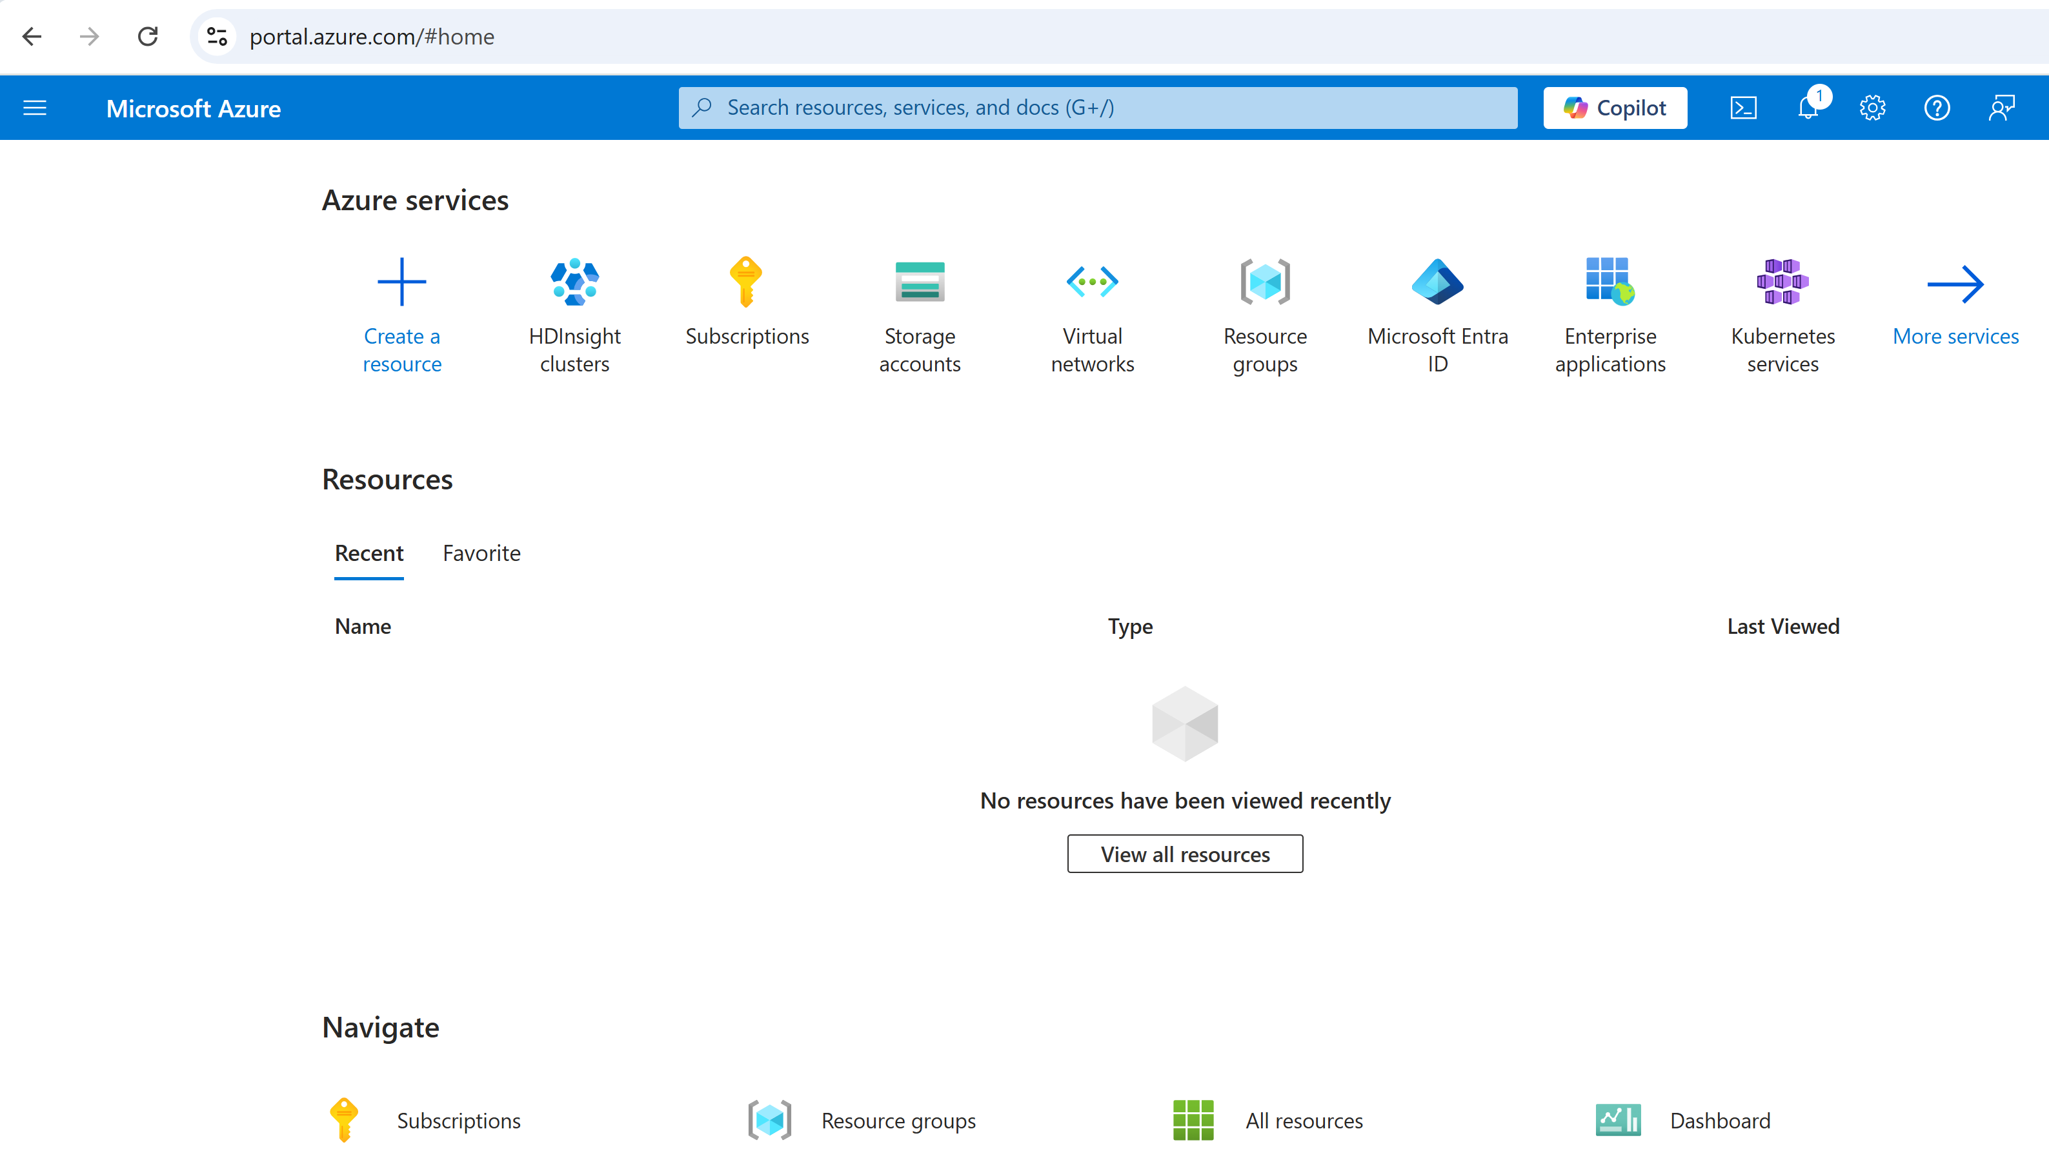
https://portal.azure.com Home page => Azure Services

Slide 3
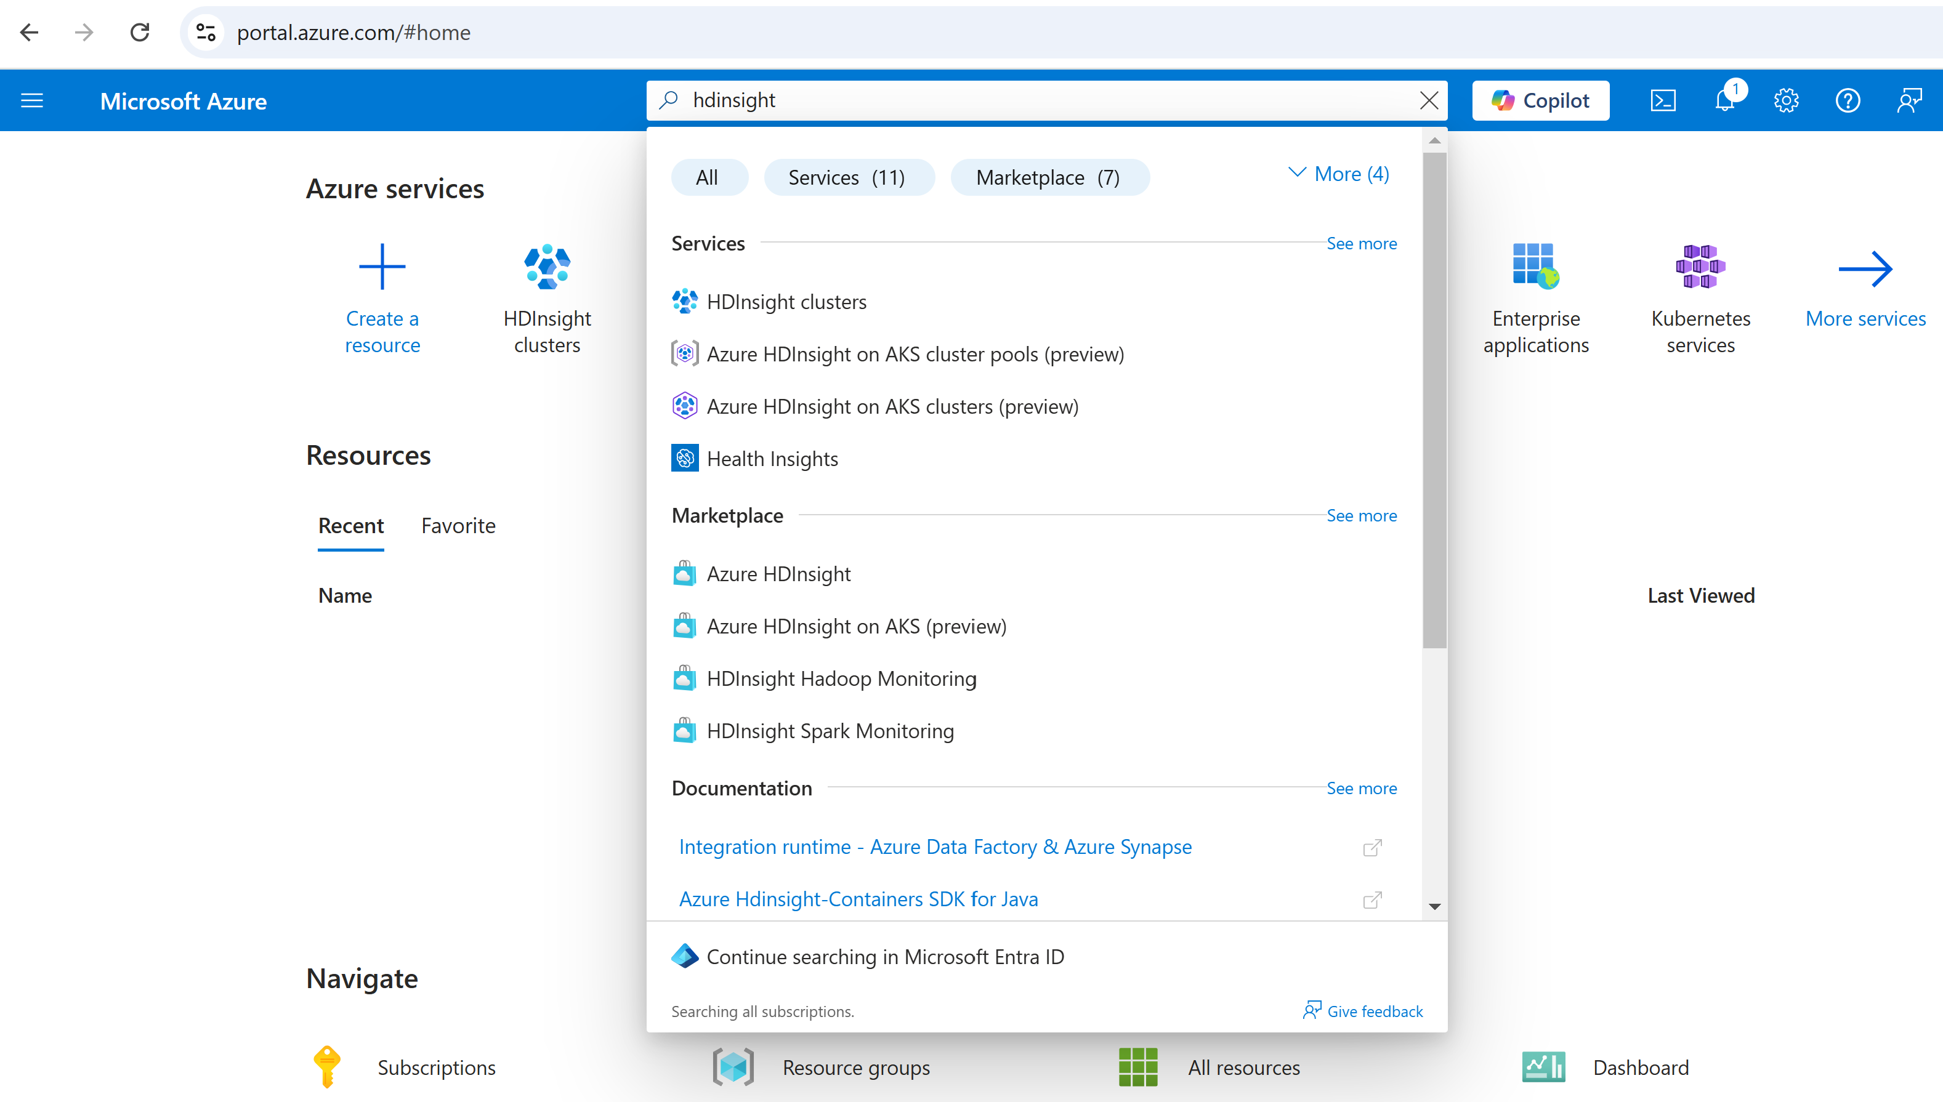
https://portal.azure.com
Search service "hdinsight"

Slide 4
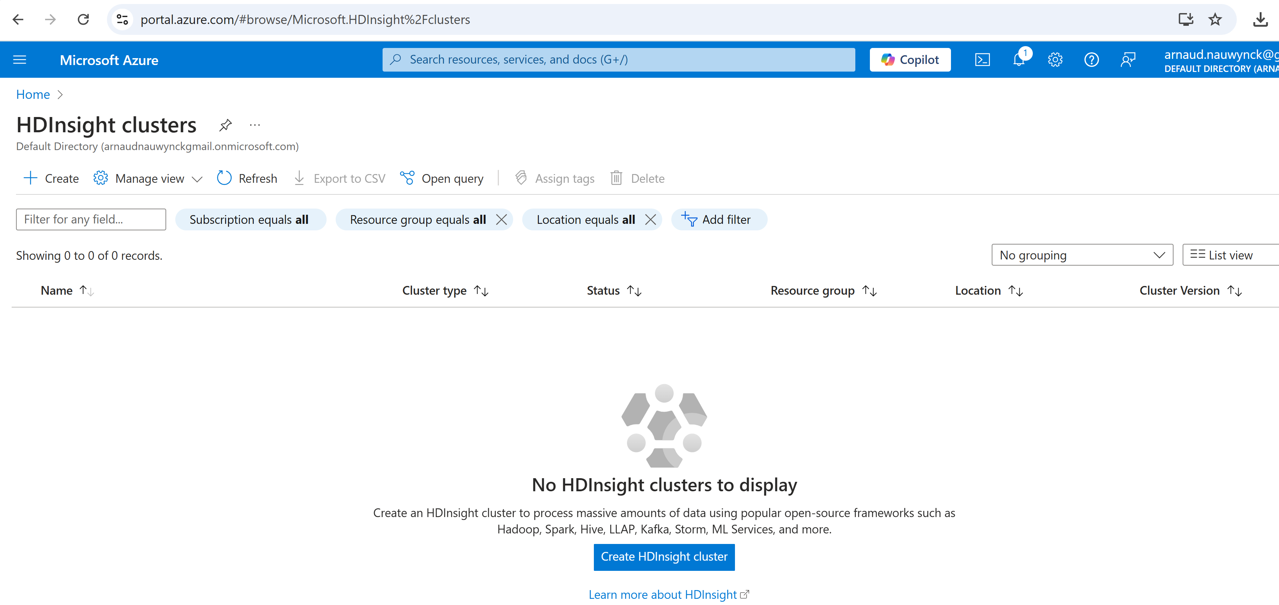
List of Provisioned HDInsight clusters

Slide 5
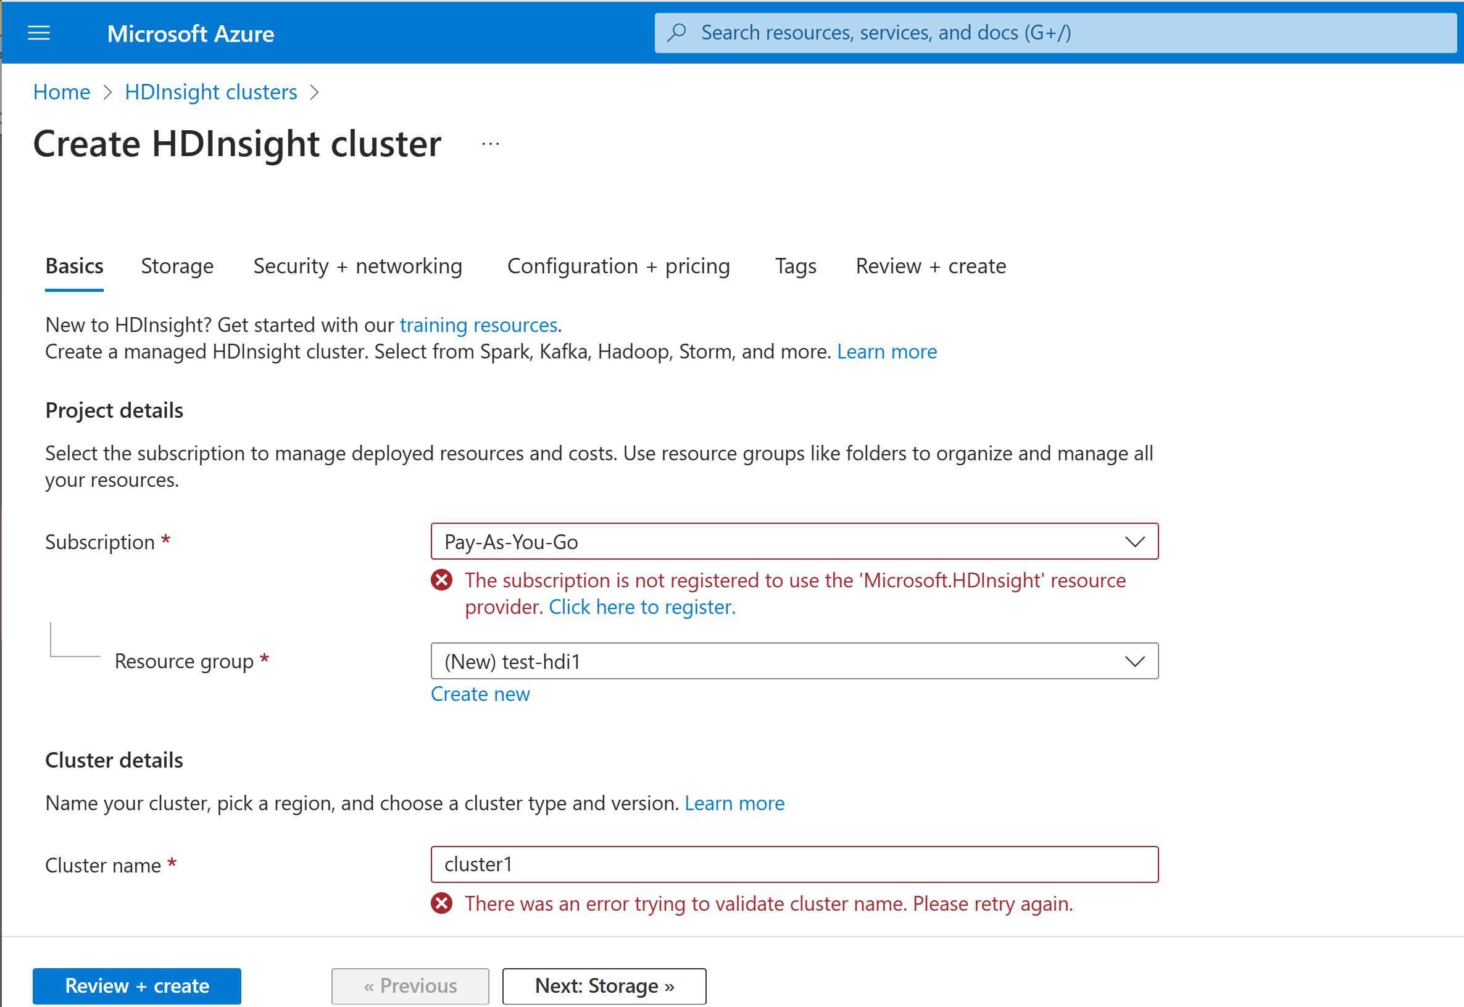
Create a Cluster
https://portal.azure.com/#create/Microsoft.HDInsightCluster

Slide 6
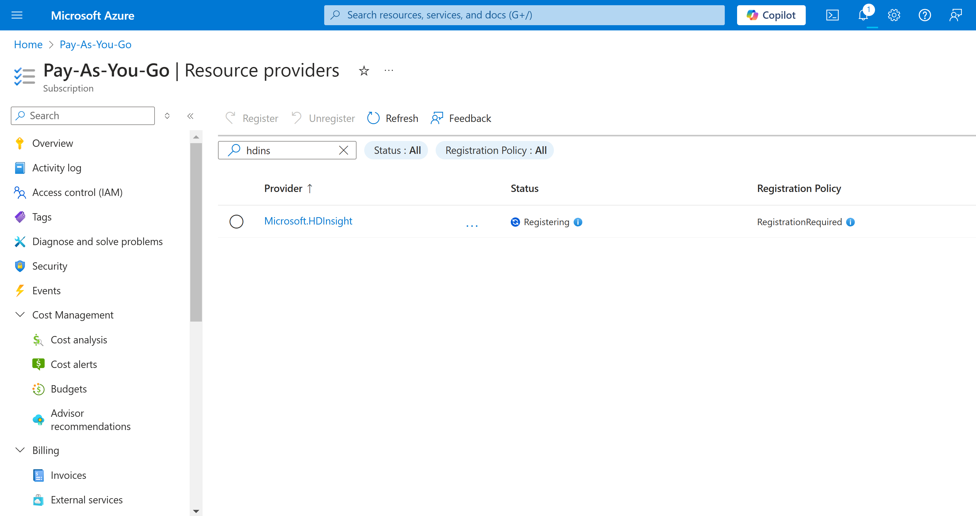
Need Register Feature

Slide 7
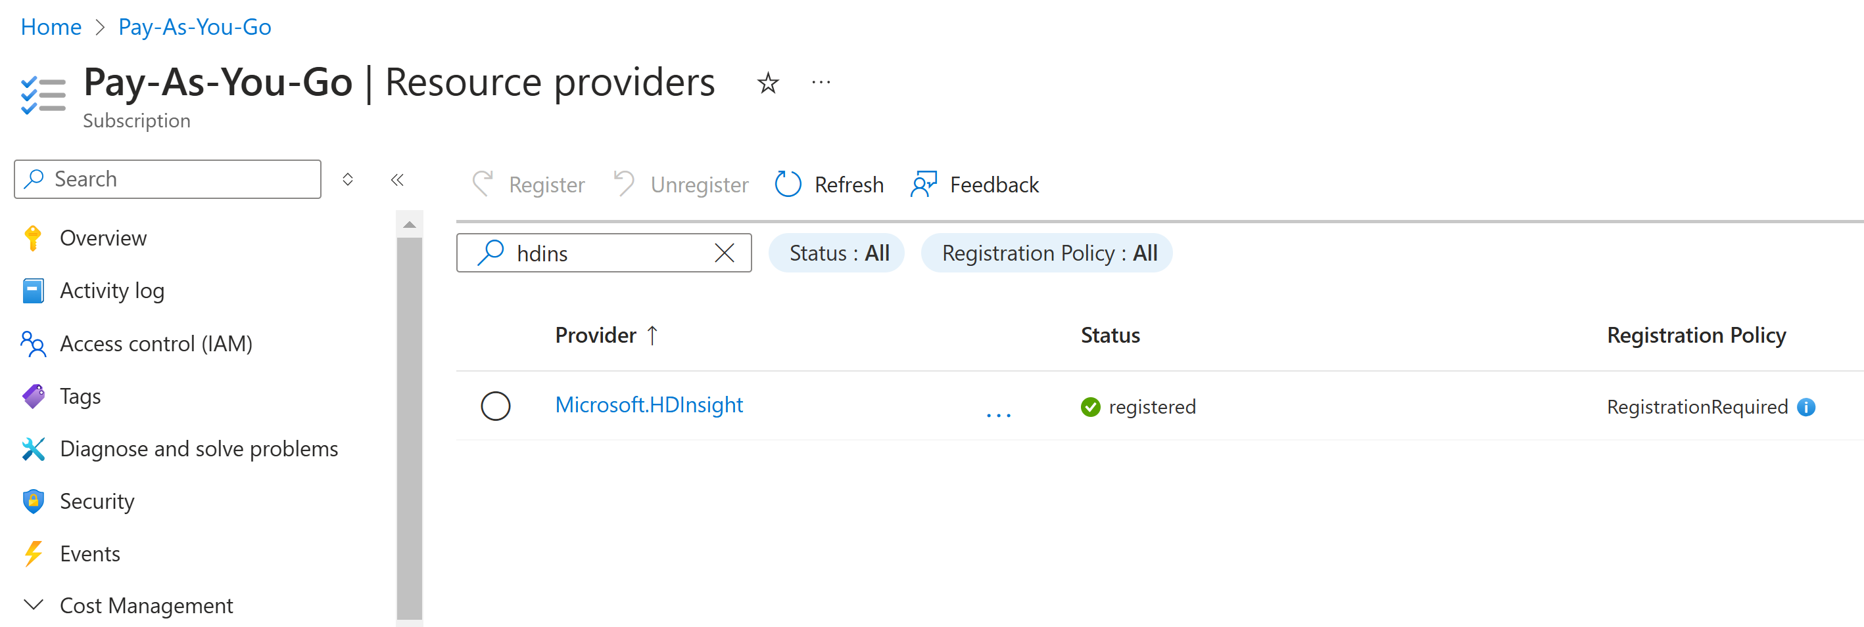
Select HDInsight, click "Register" ... wait few minutes

Slide 8
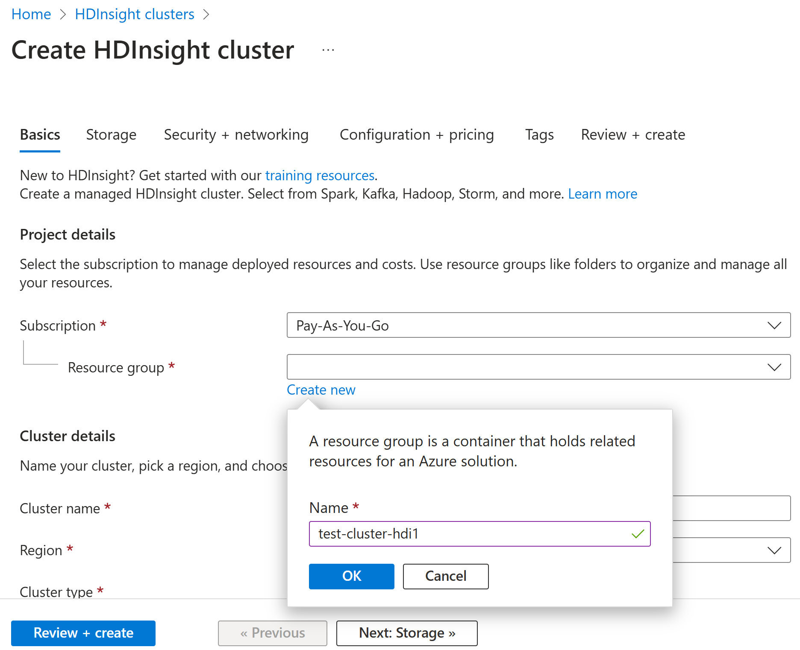
Create HDI - Step 1: Create Resource Group

Slide 9
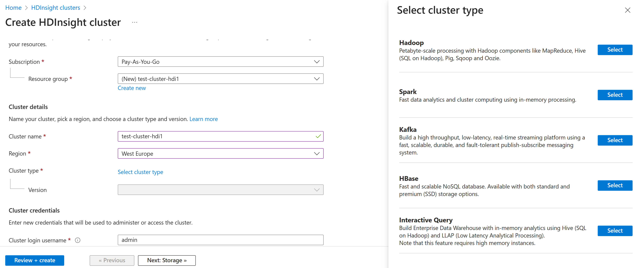
Create HDI - Choose Cluster Type (=> Spark)

Slide 10
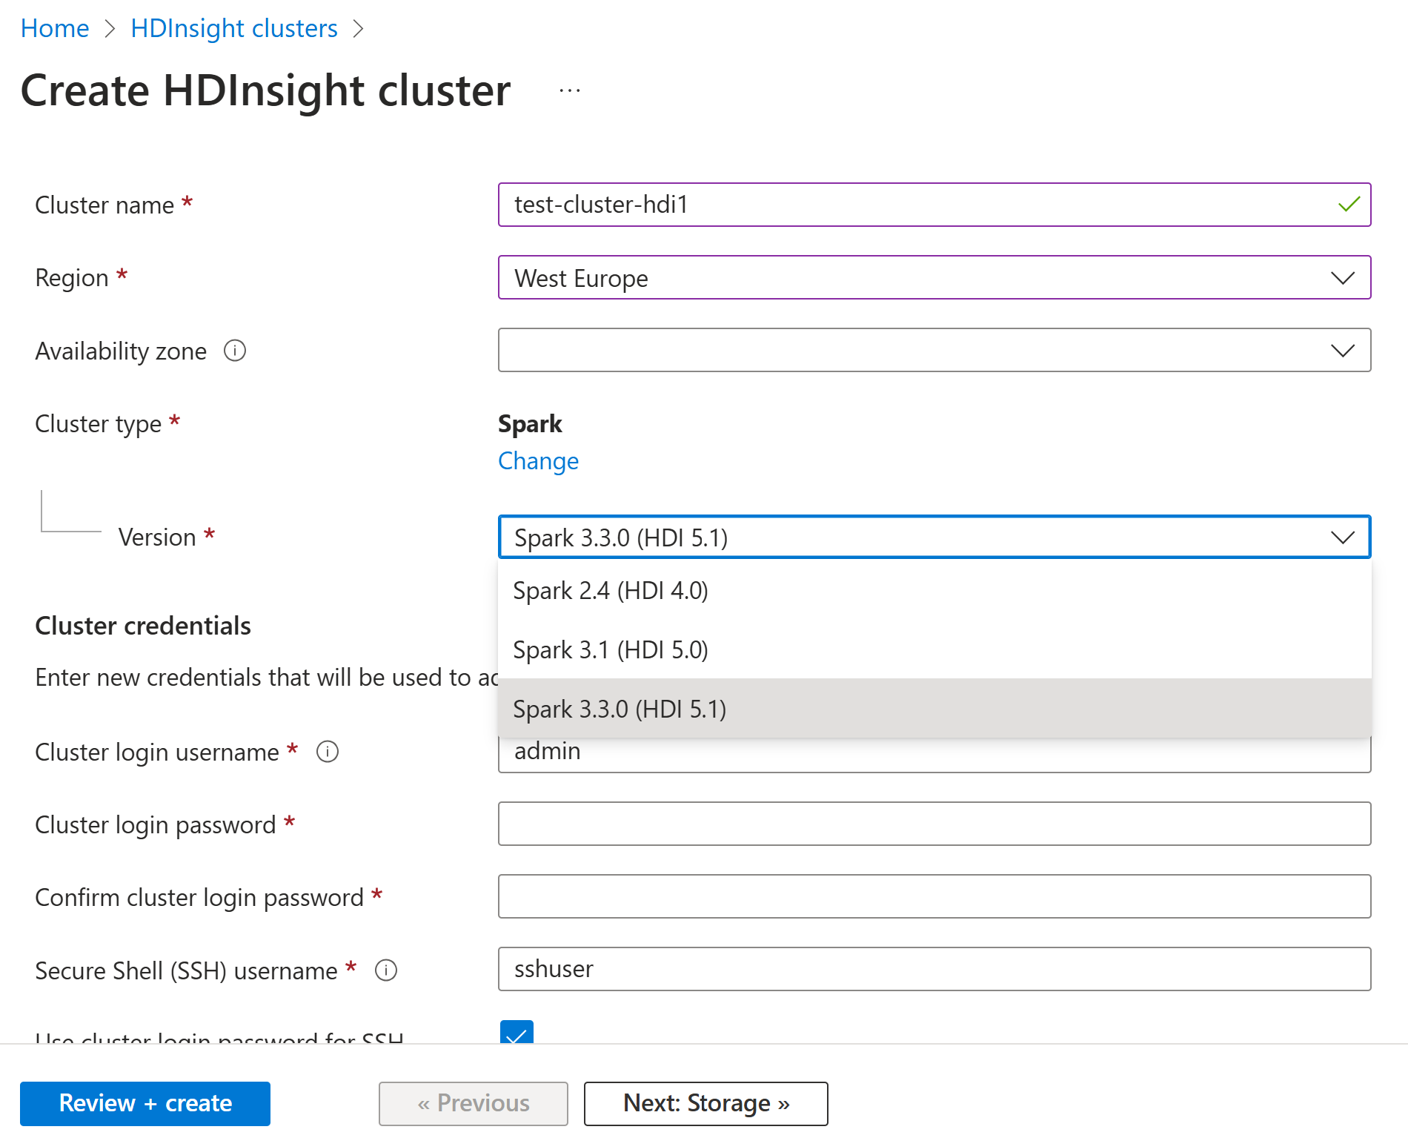
Create HDI - Choose Spark Version available 3.3.0 as of 2024 (but latest spark=3.5.3)

Slide 11
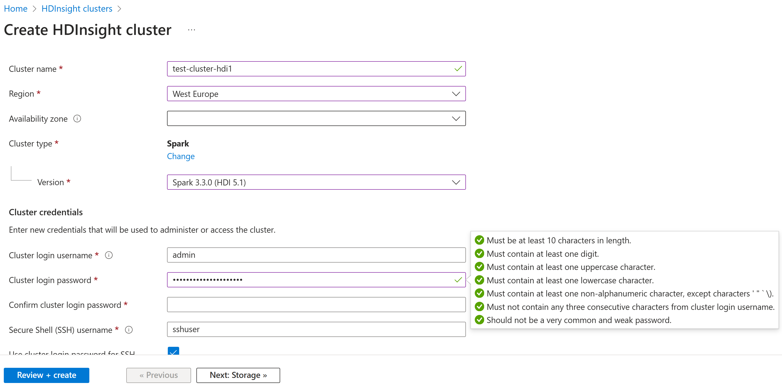
Create HDI - Admin Username + Password

Slide 12
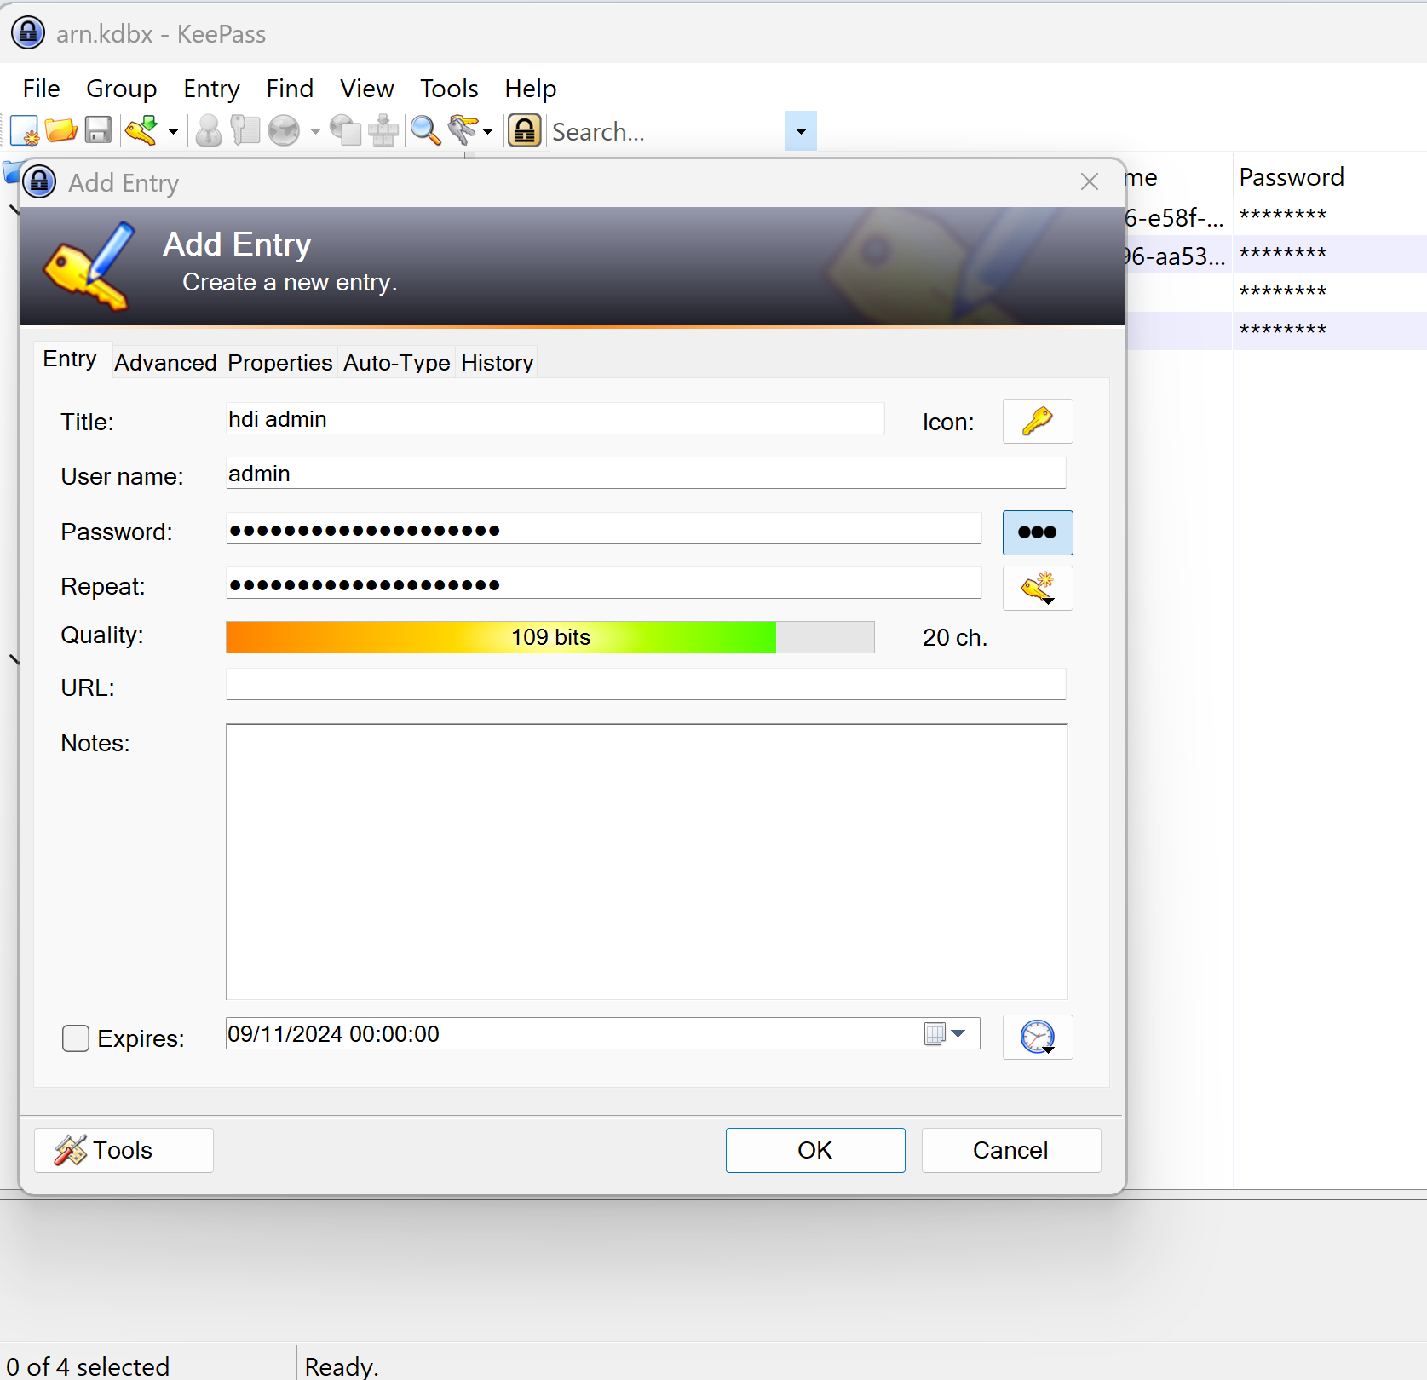
Always Generate your Random Passwords (and use KeePass)

Slide 13
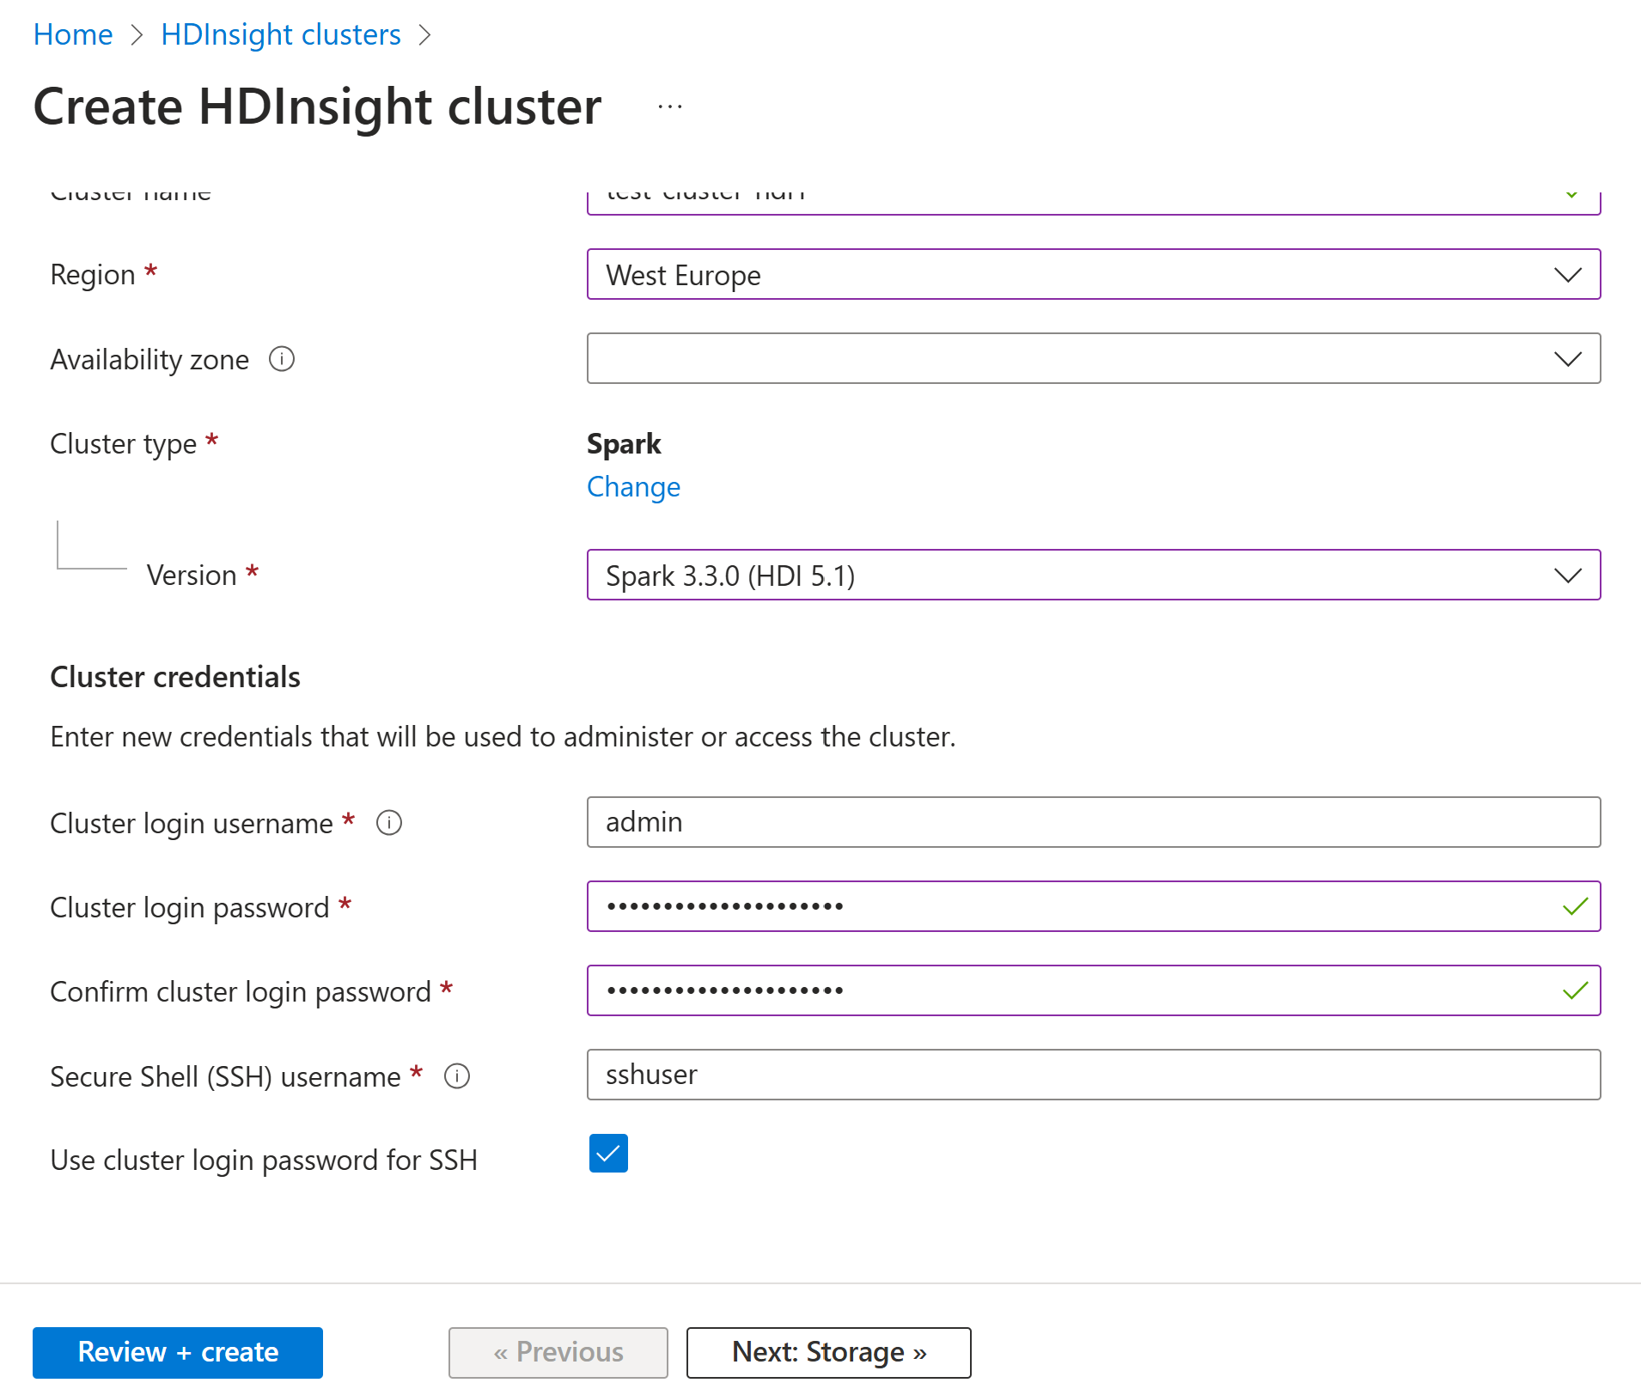
Create HDI - Next : Storage

Slide 14
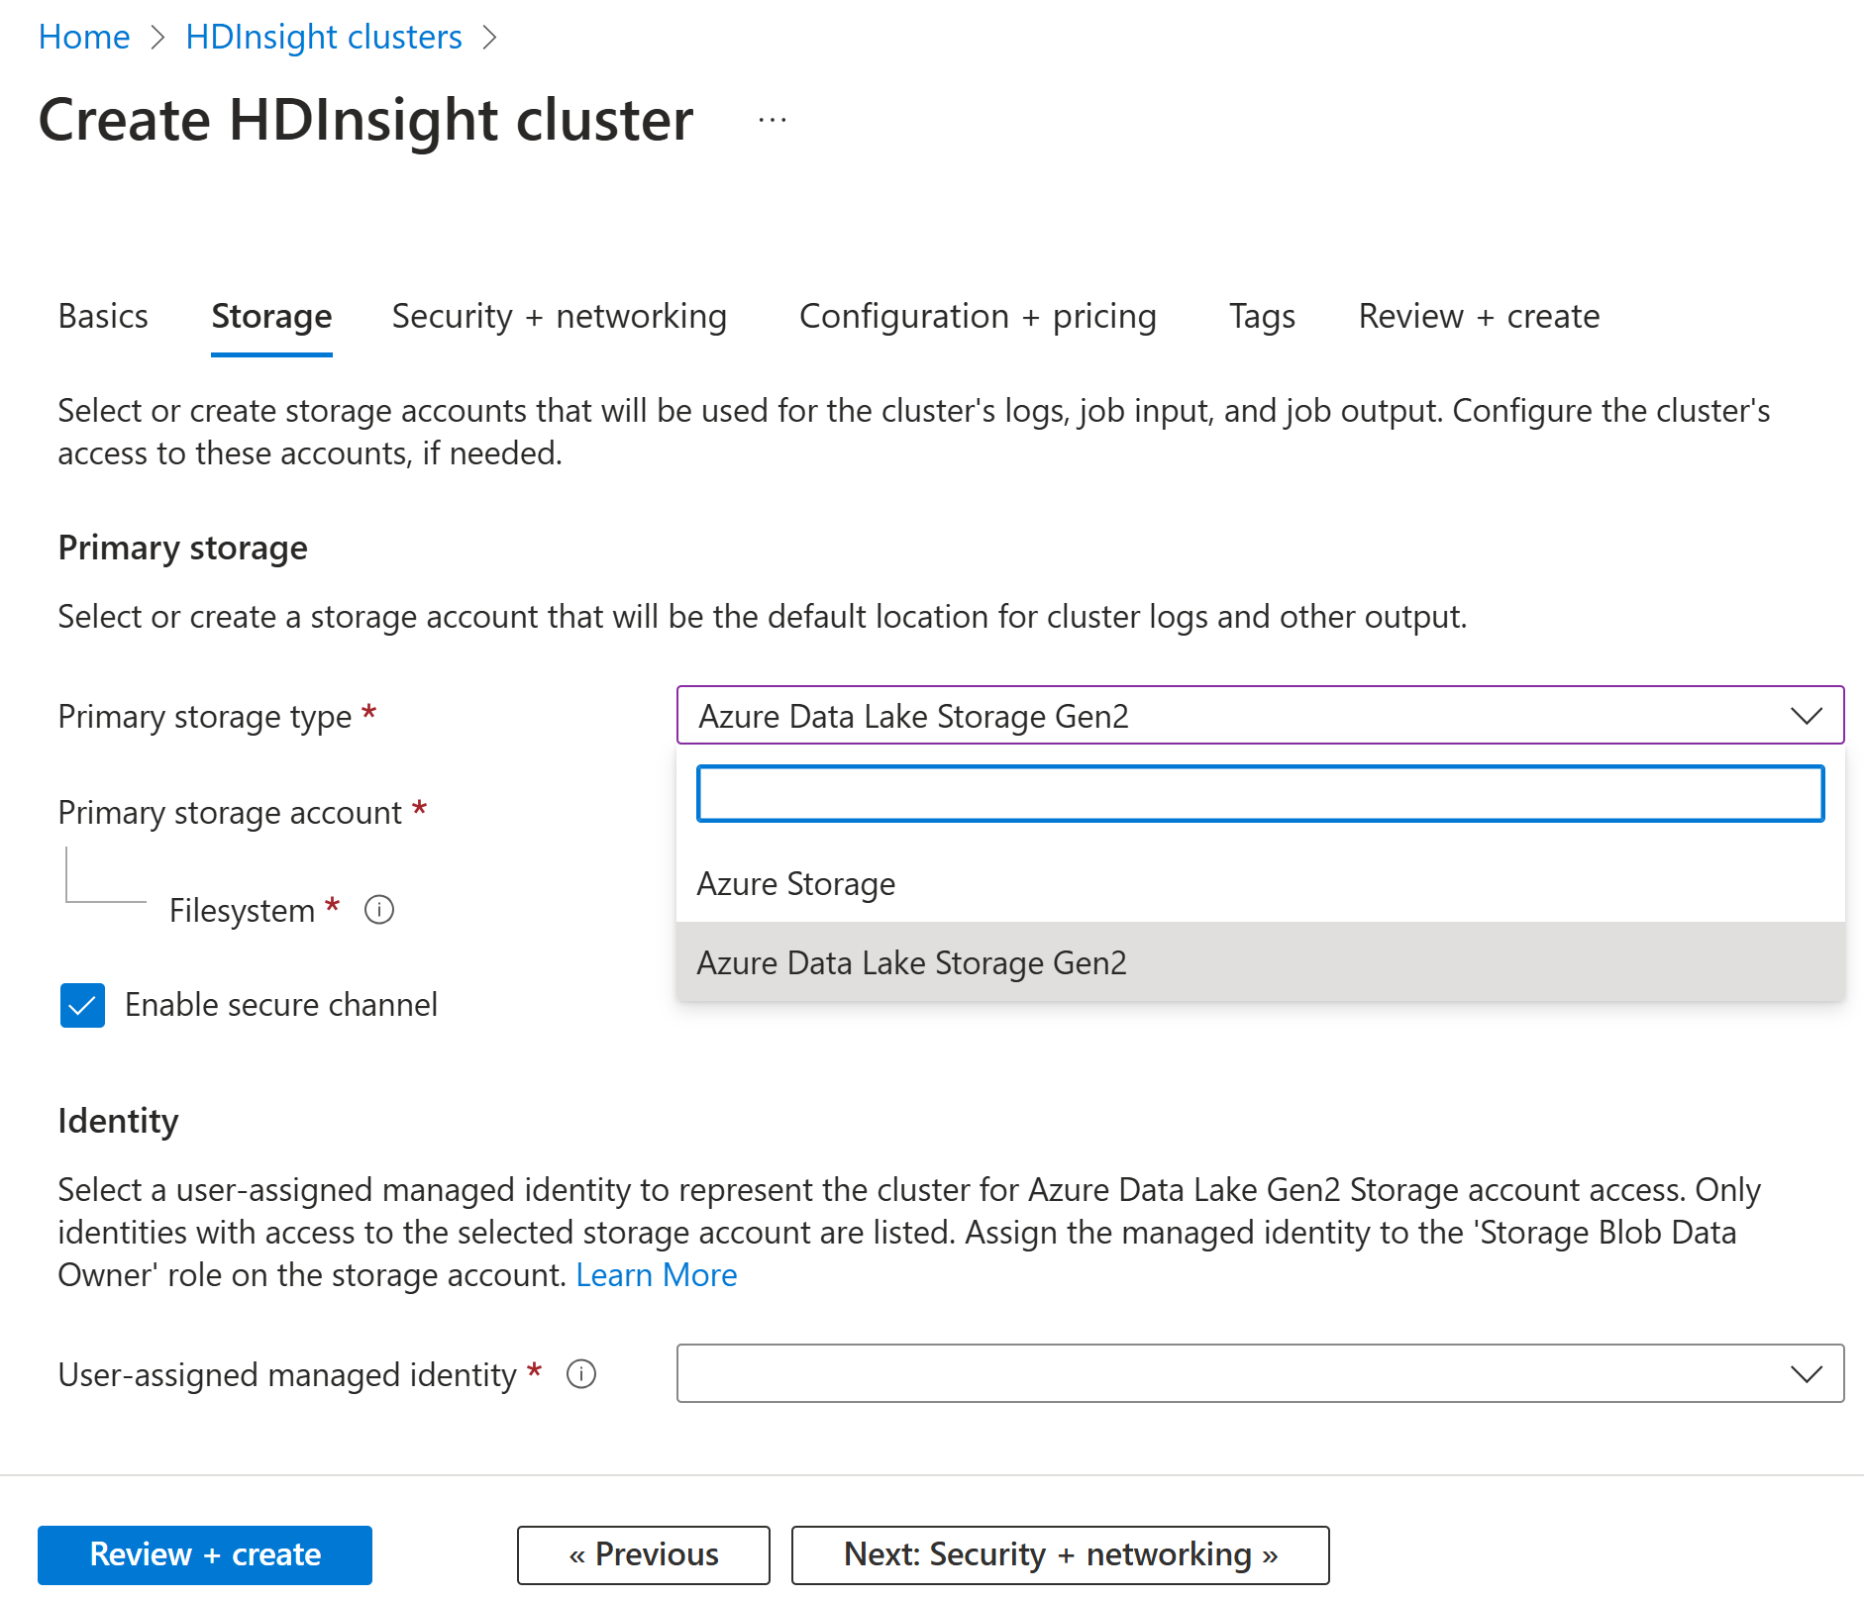
change default Storage Type "ADLS Gen 2"

Slide 15
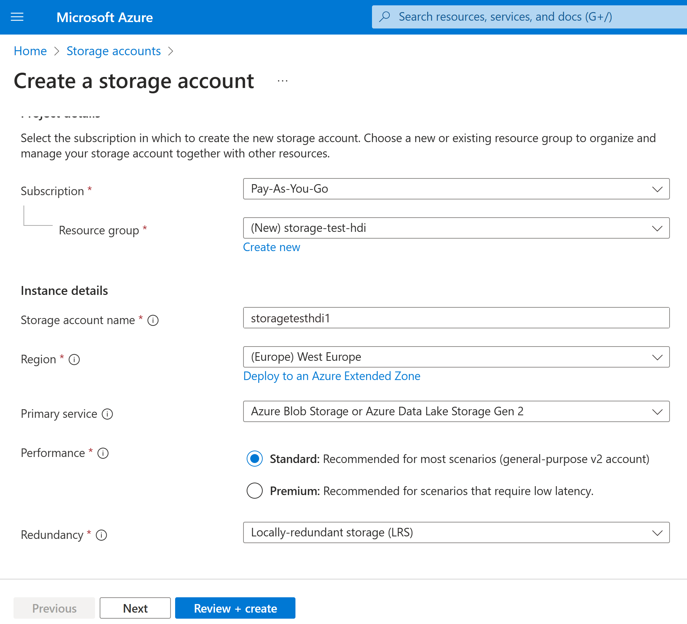
Create a Storage Account (in same Region, with type ADLSGen2)

Slide 16
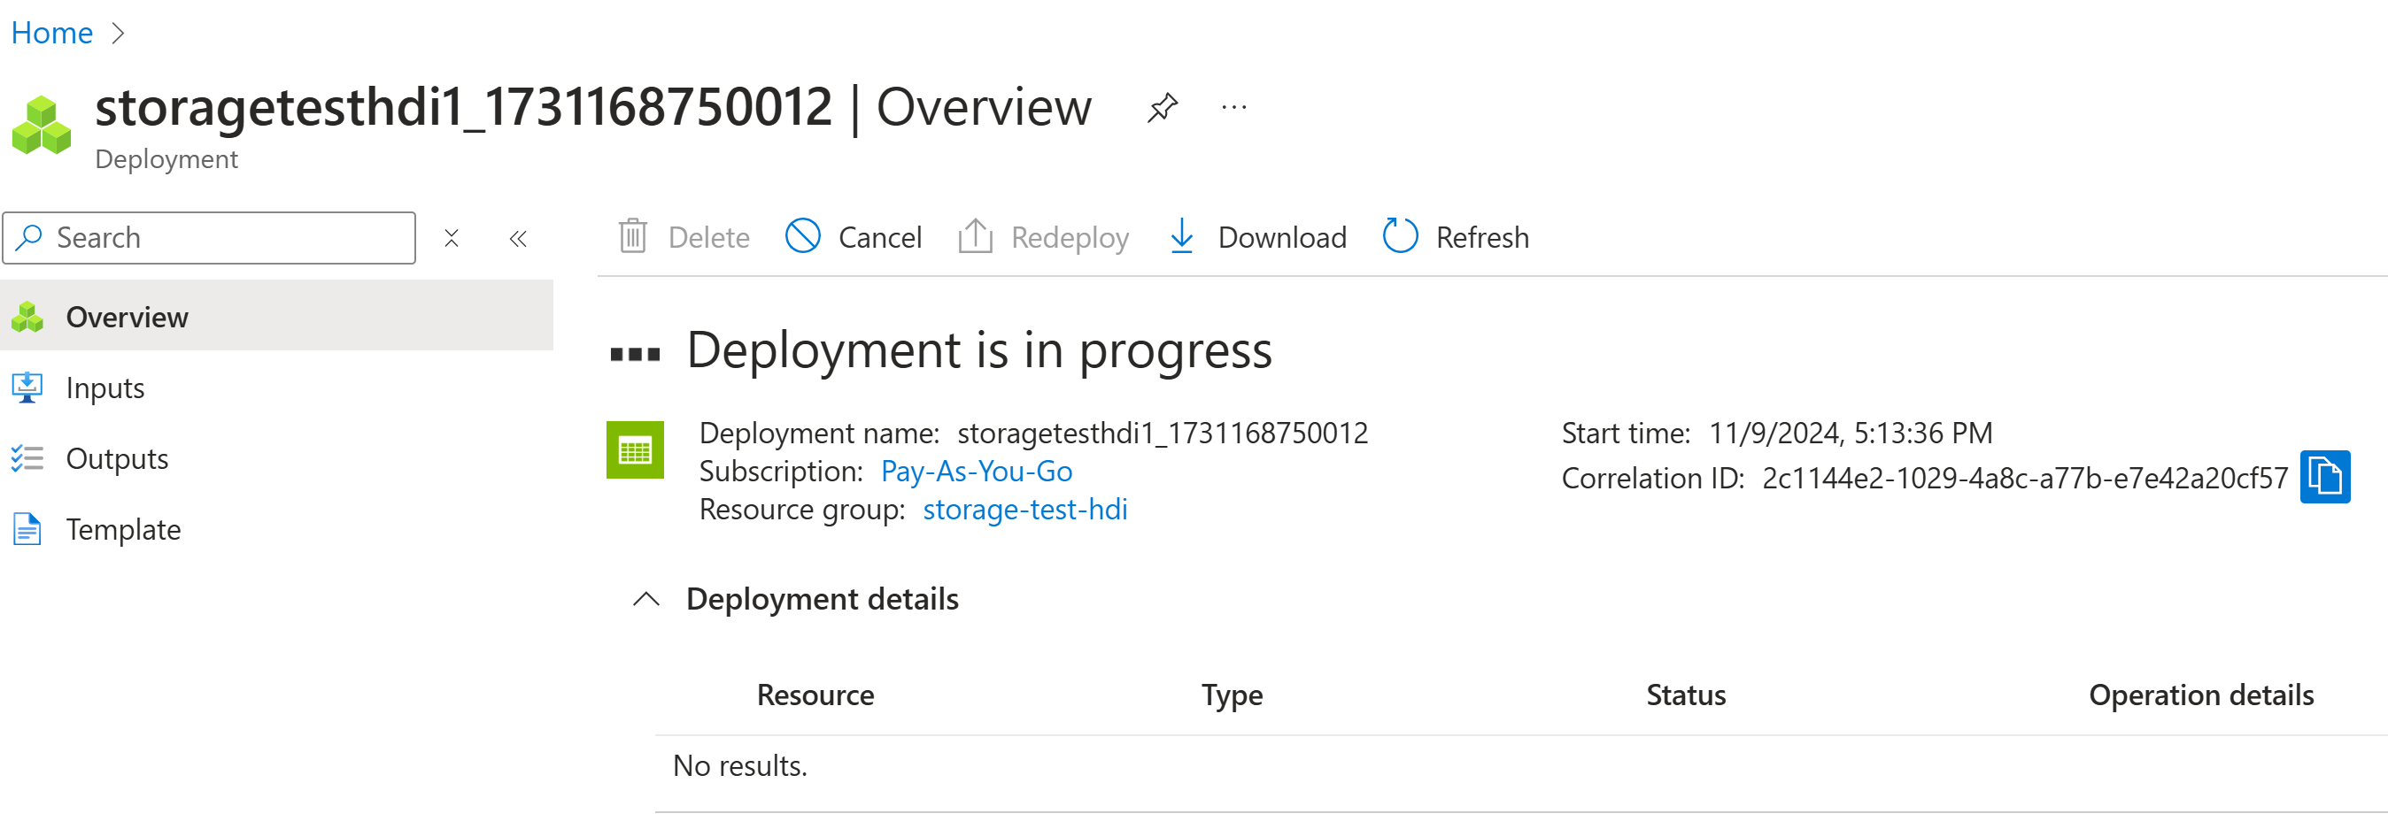
Creating Storage Account...

Slide 17
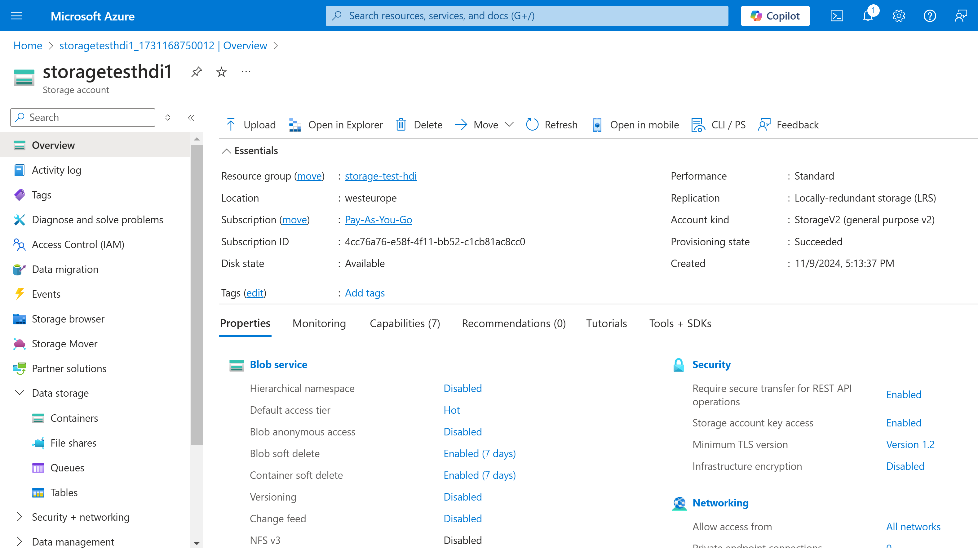
Created Storage Account

Slide 18
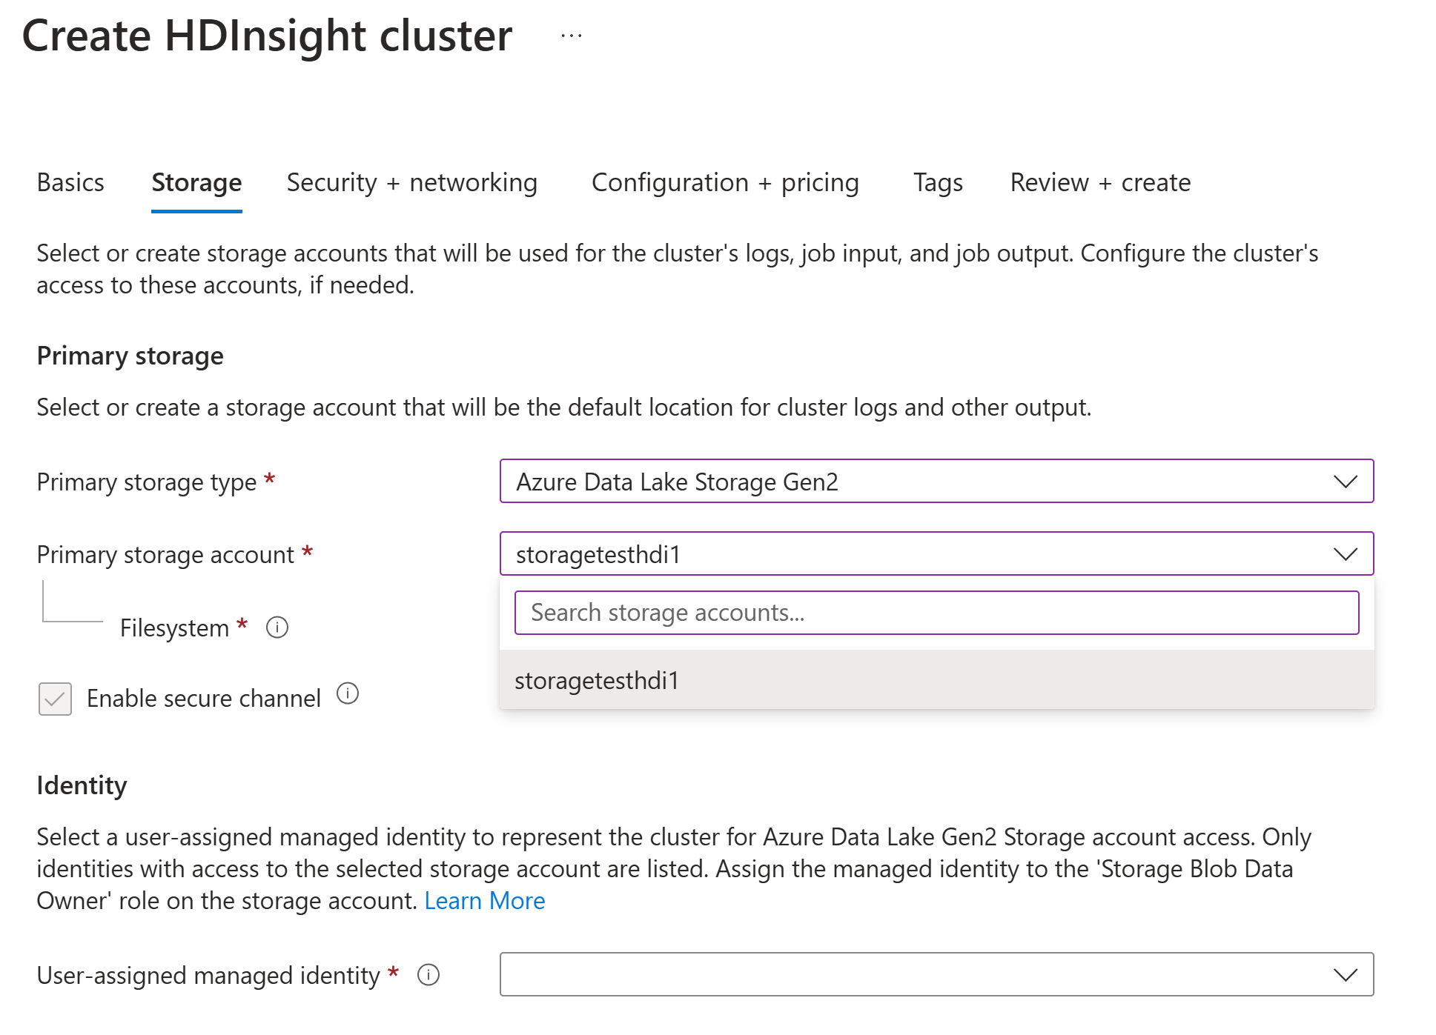
Create HDI - Select your Storage Account (bug Azure ... need close+reenter HDI Form)

Slide 19
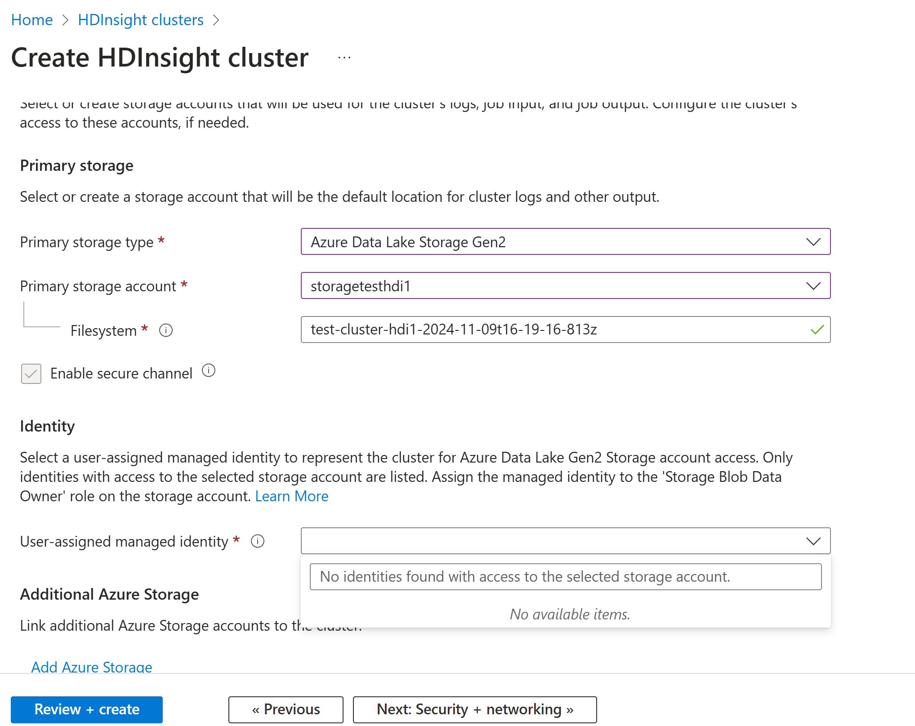
... Need a Managed Identity

Slide 20
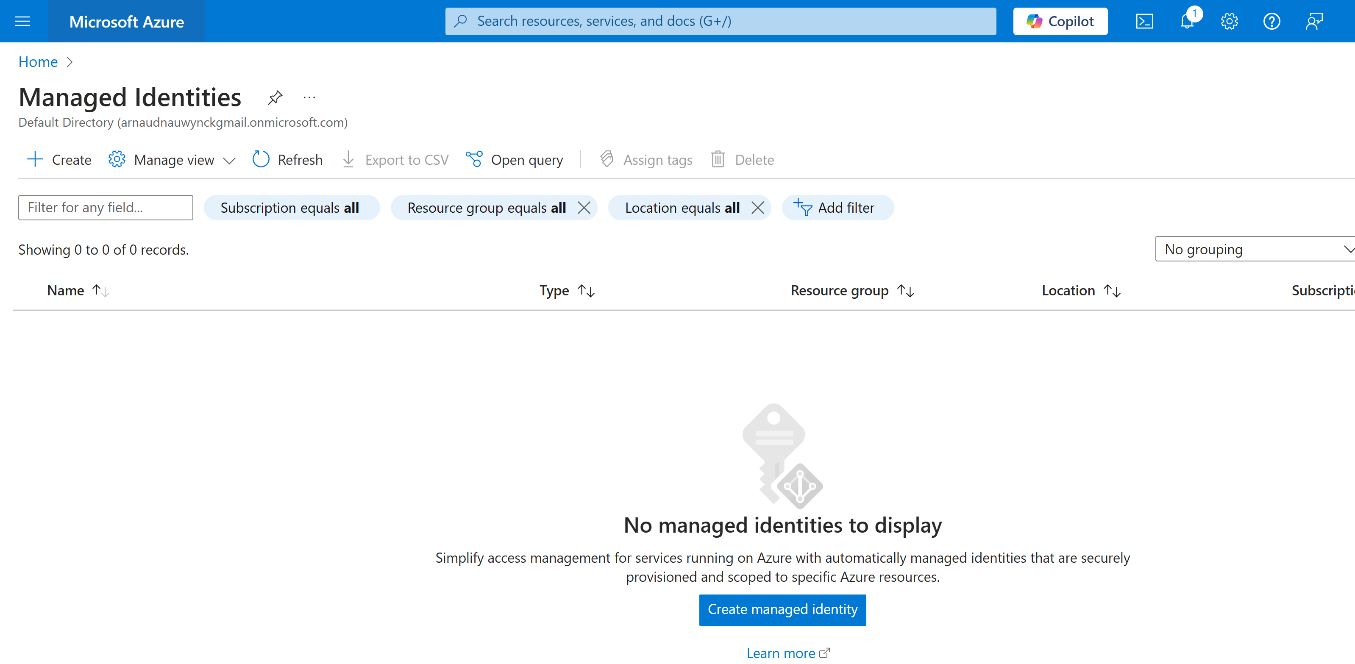
Managed Identity

Slide 21
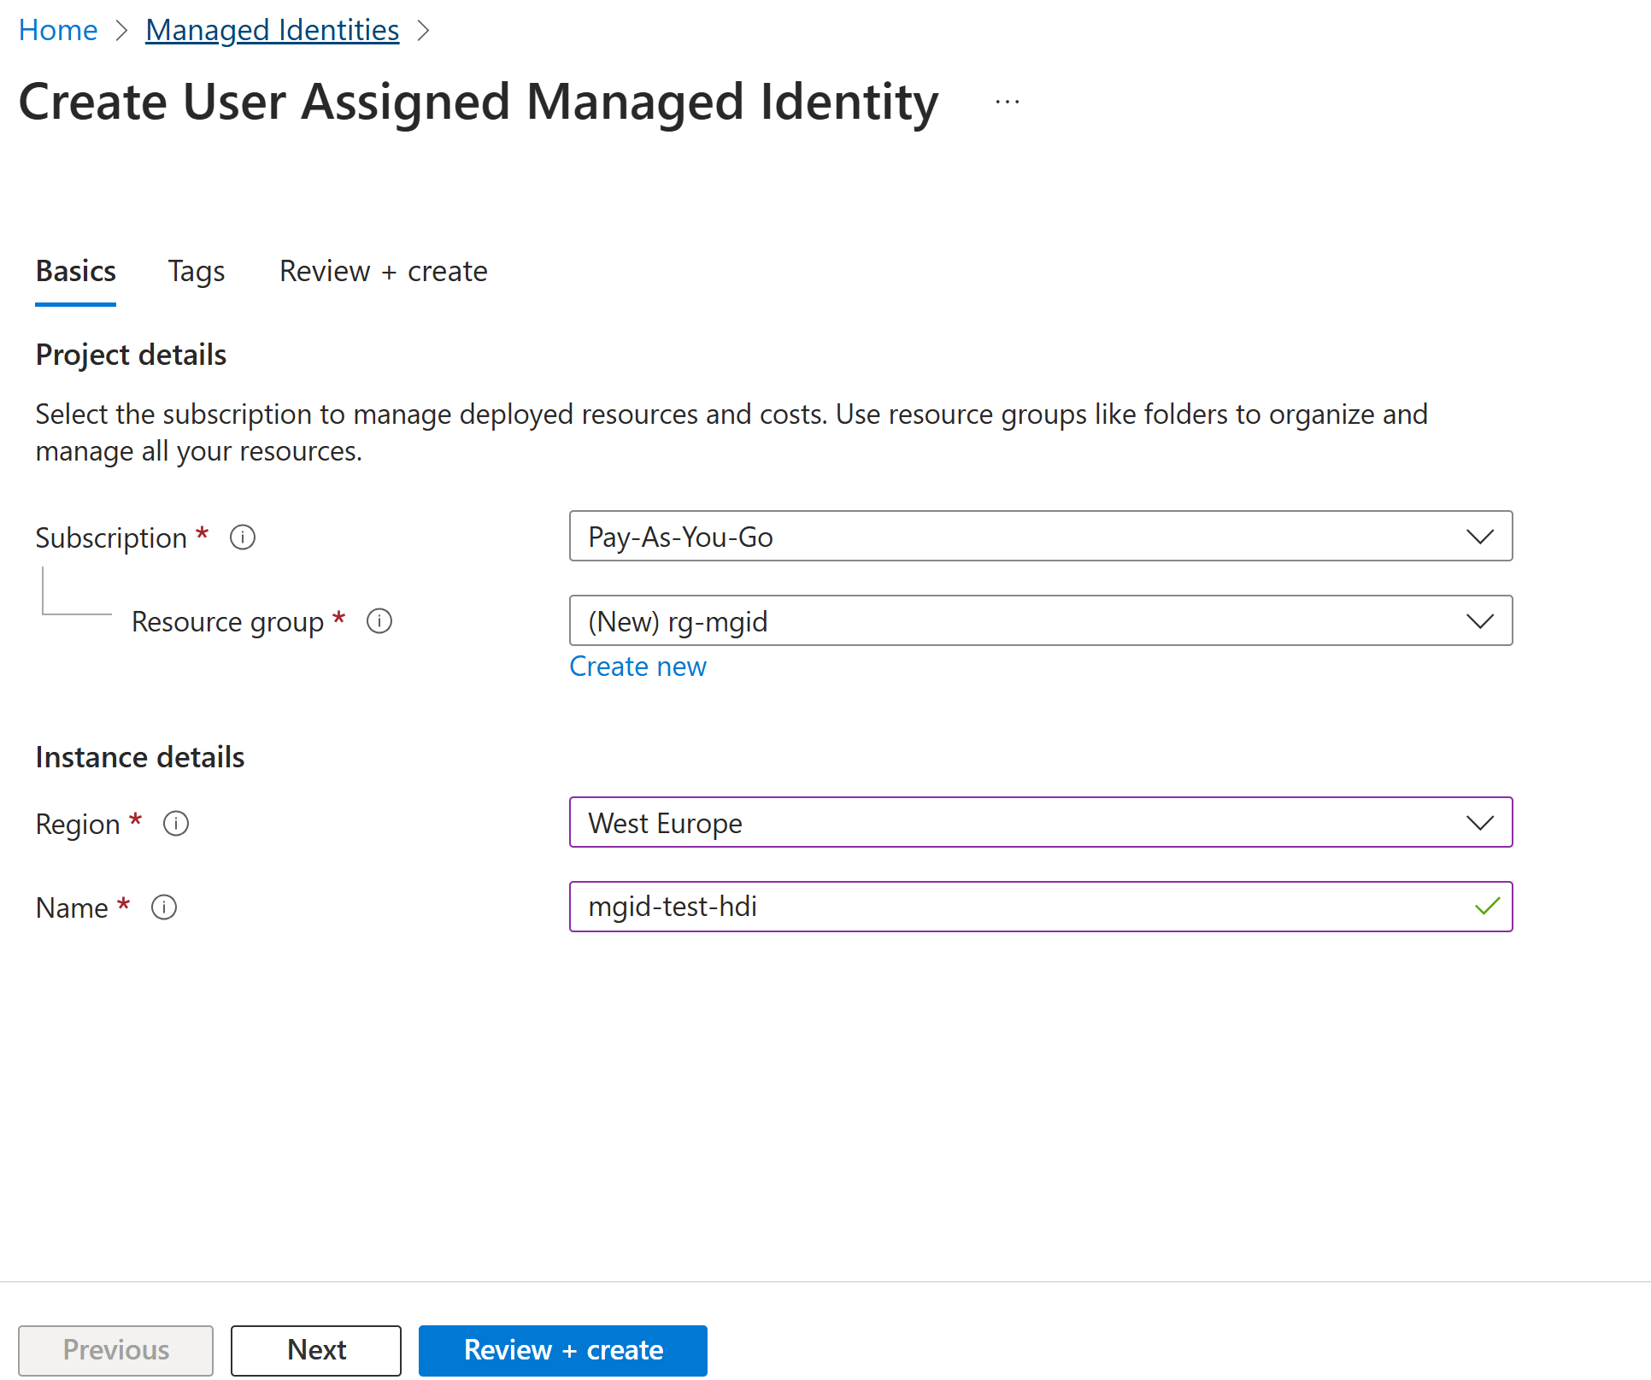
Create Managed Identity

Slide 22
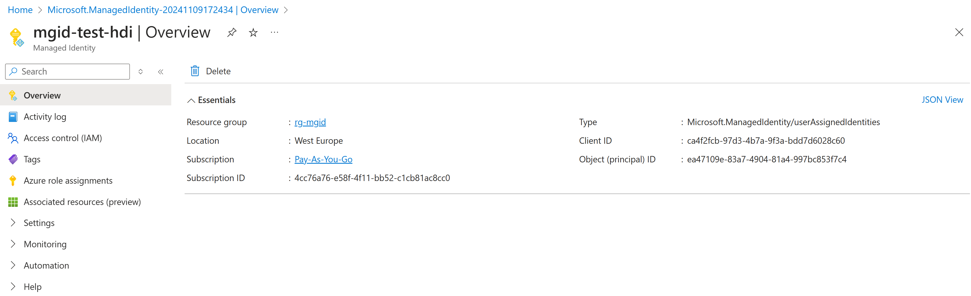
Managed Identity

Slide 23
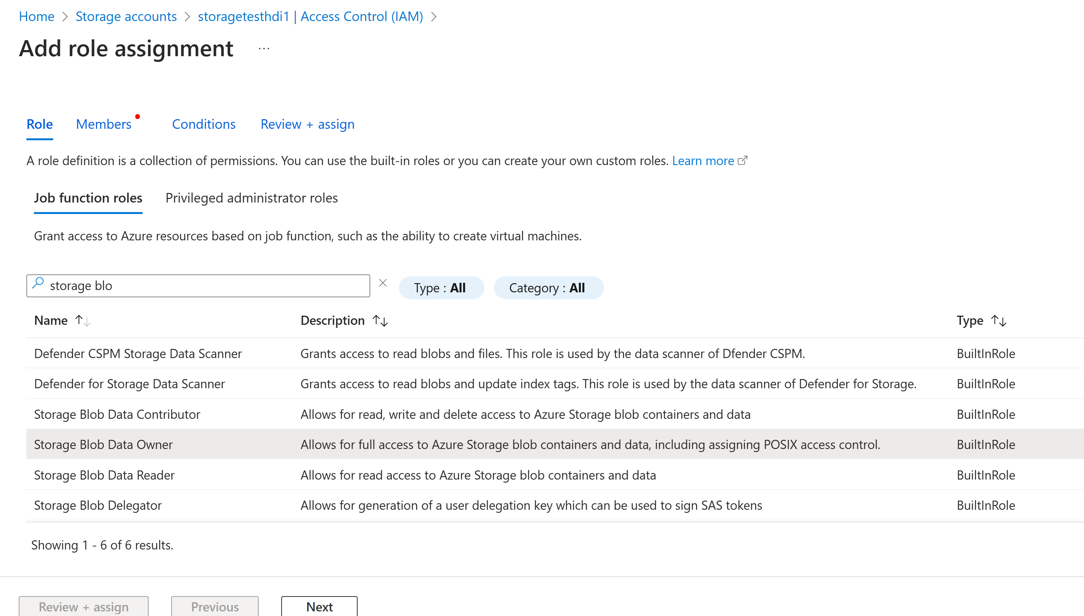
Adding "Storage Blob Data Owner" Role to Managed Identity

Slide 24
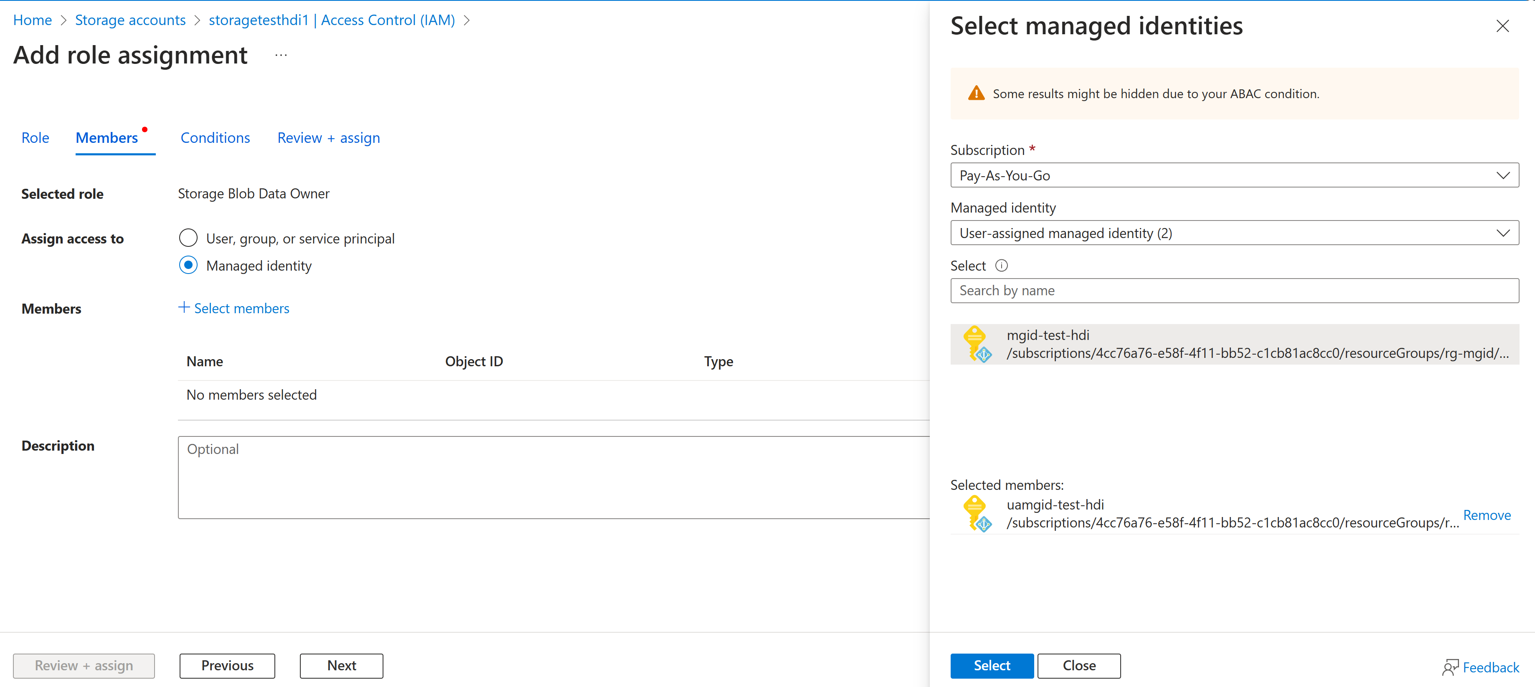
Adding Role..

Slide 25
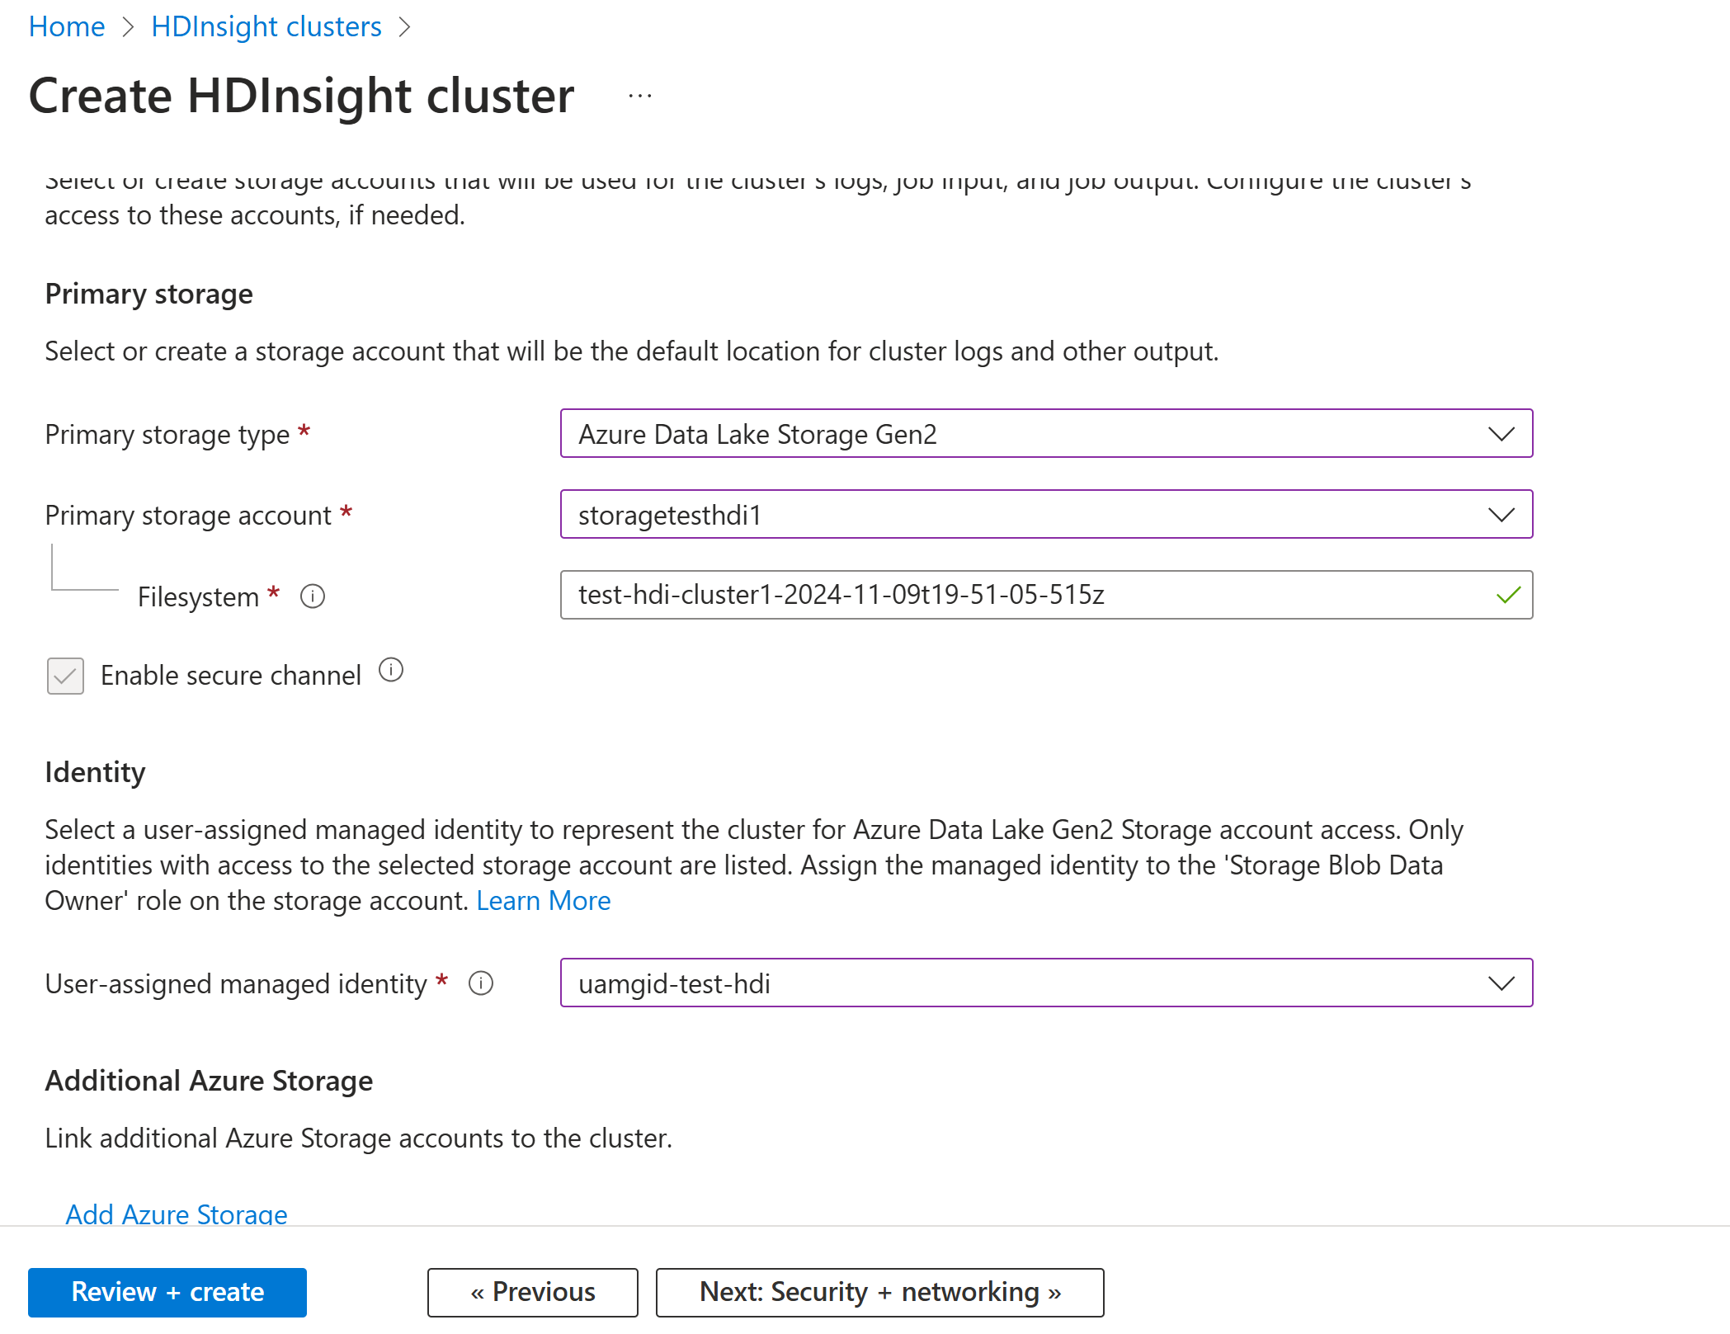
Create HDI - Managed Identity

Slide 26
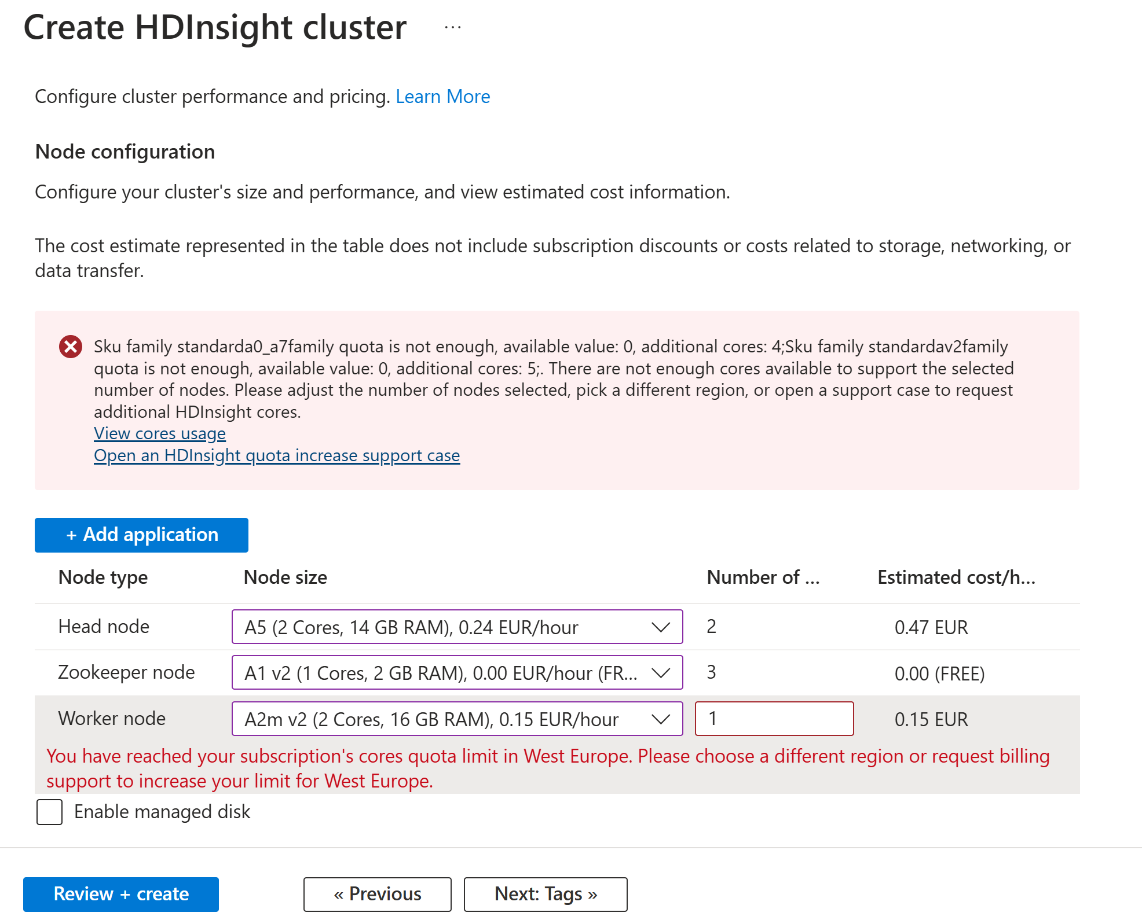
HDI.. Need Increase Subscription Cores Quota Limit

Slide 27
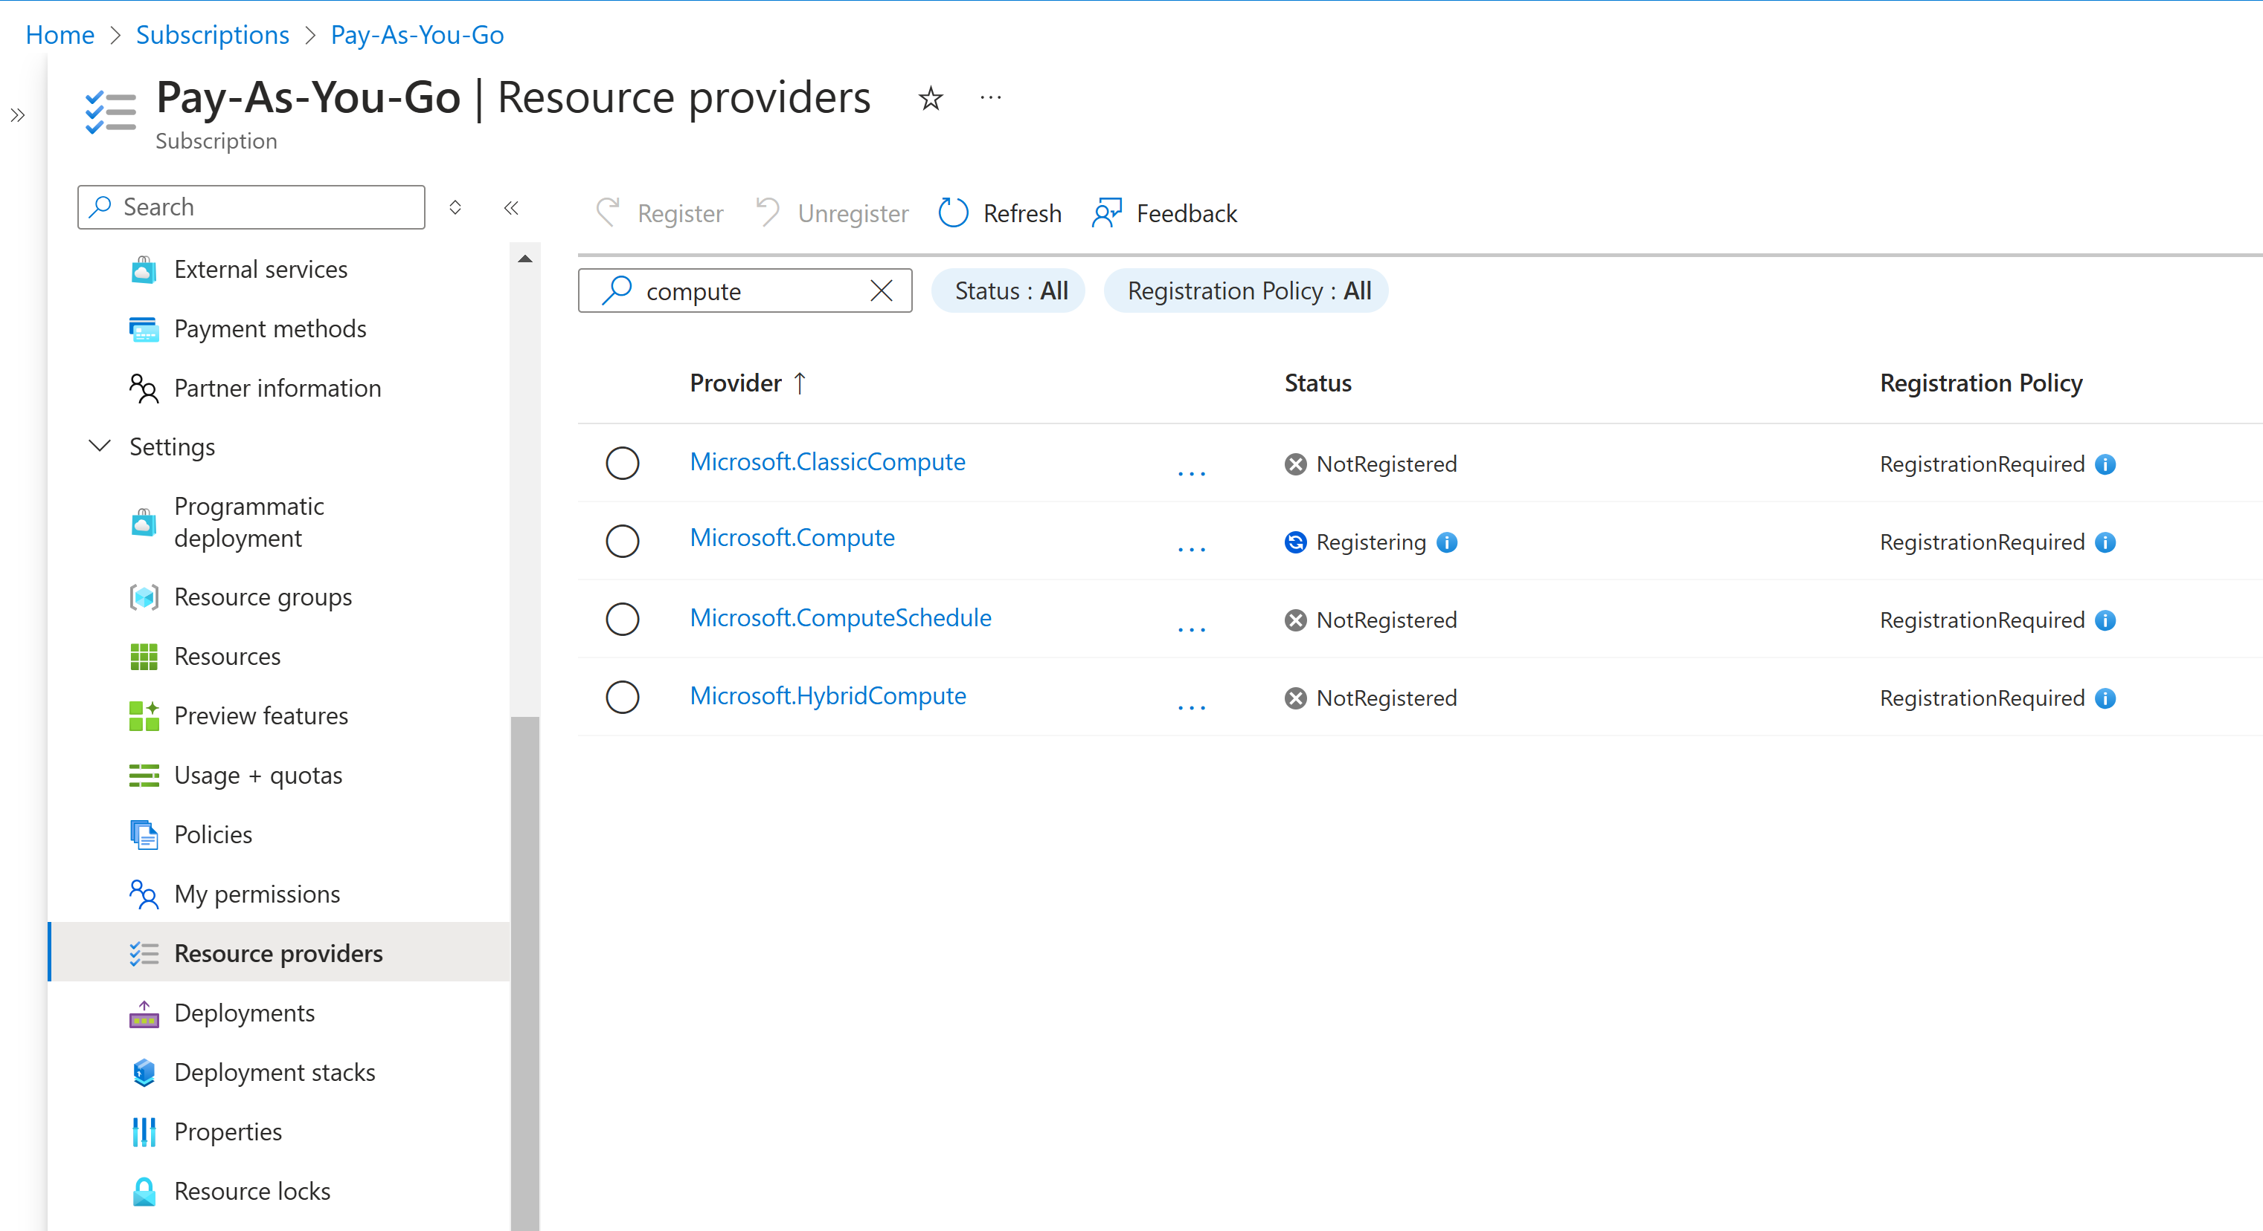
For Quota .. need Resource provider "Microsoft.Compute"

Slide 28
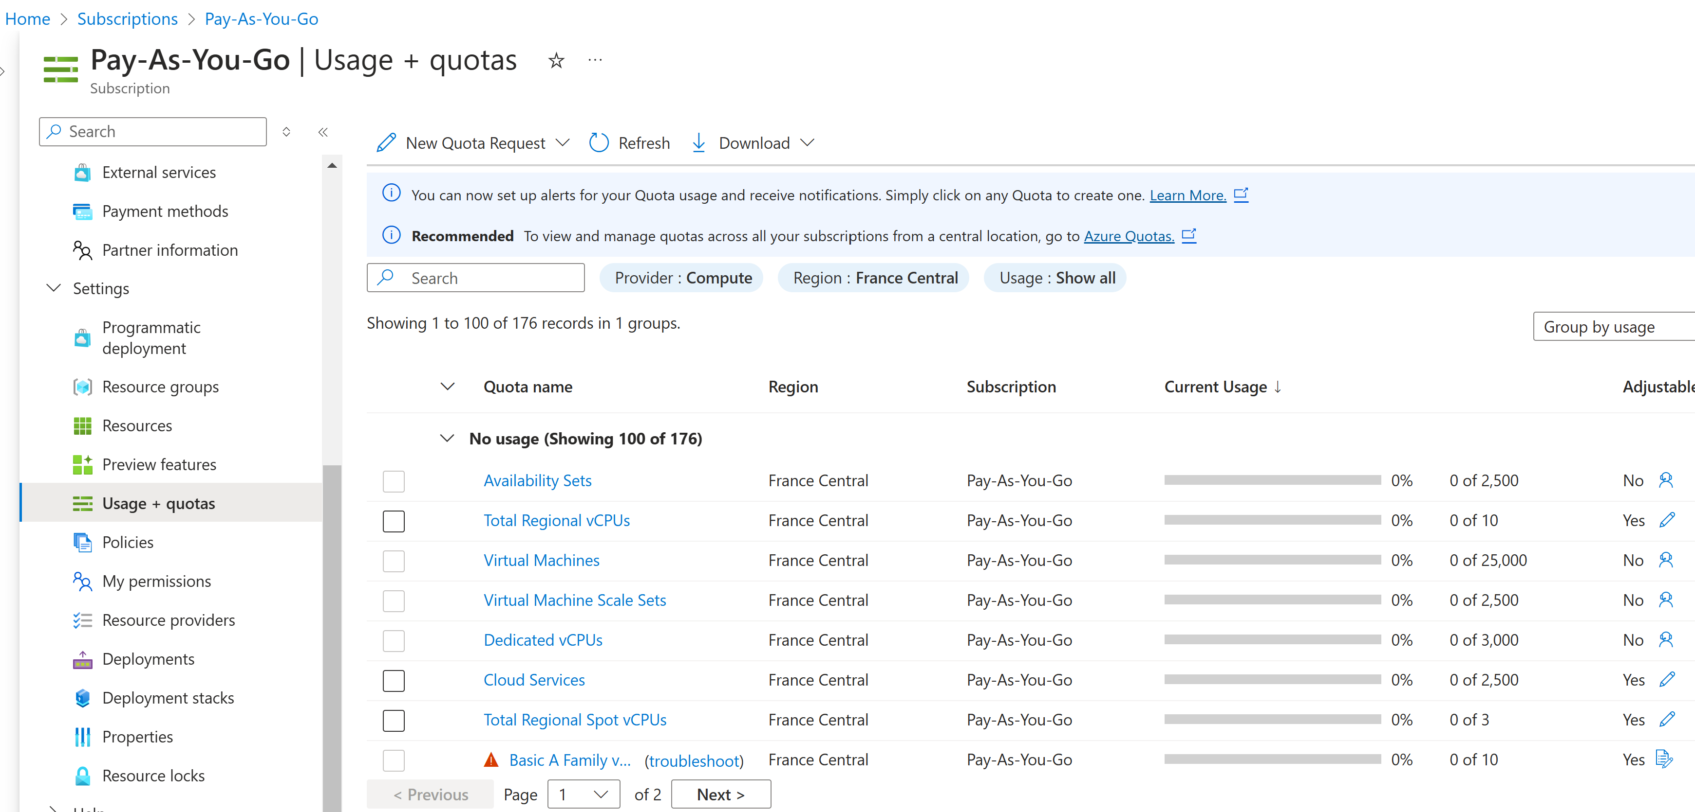
Quota vCPUs

Slide 29
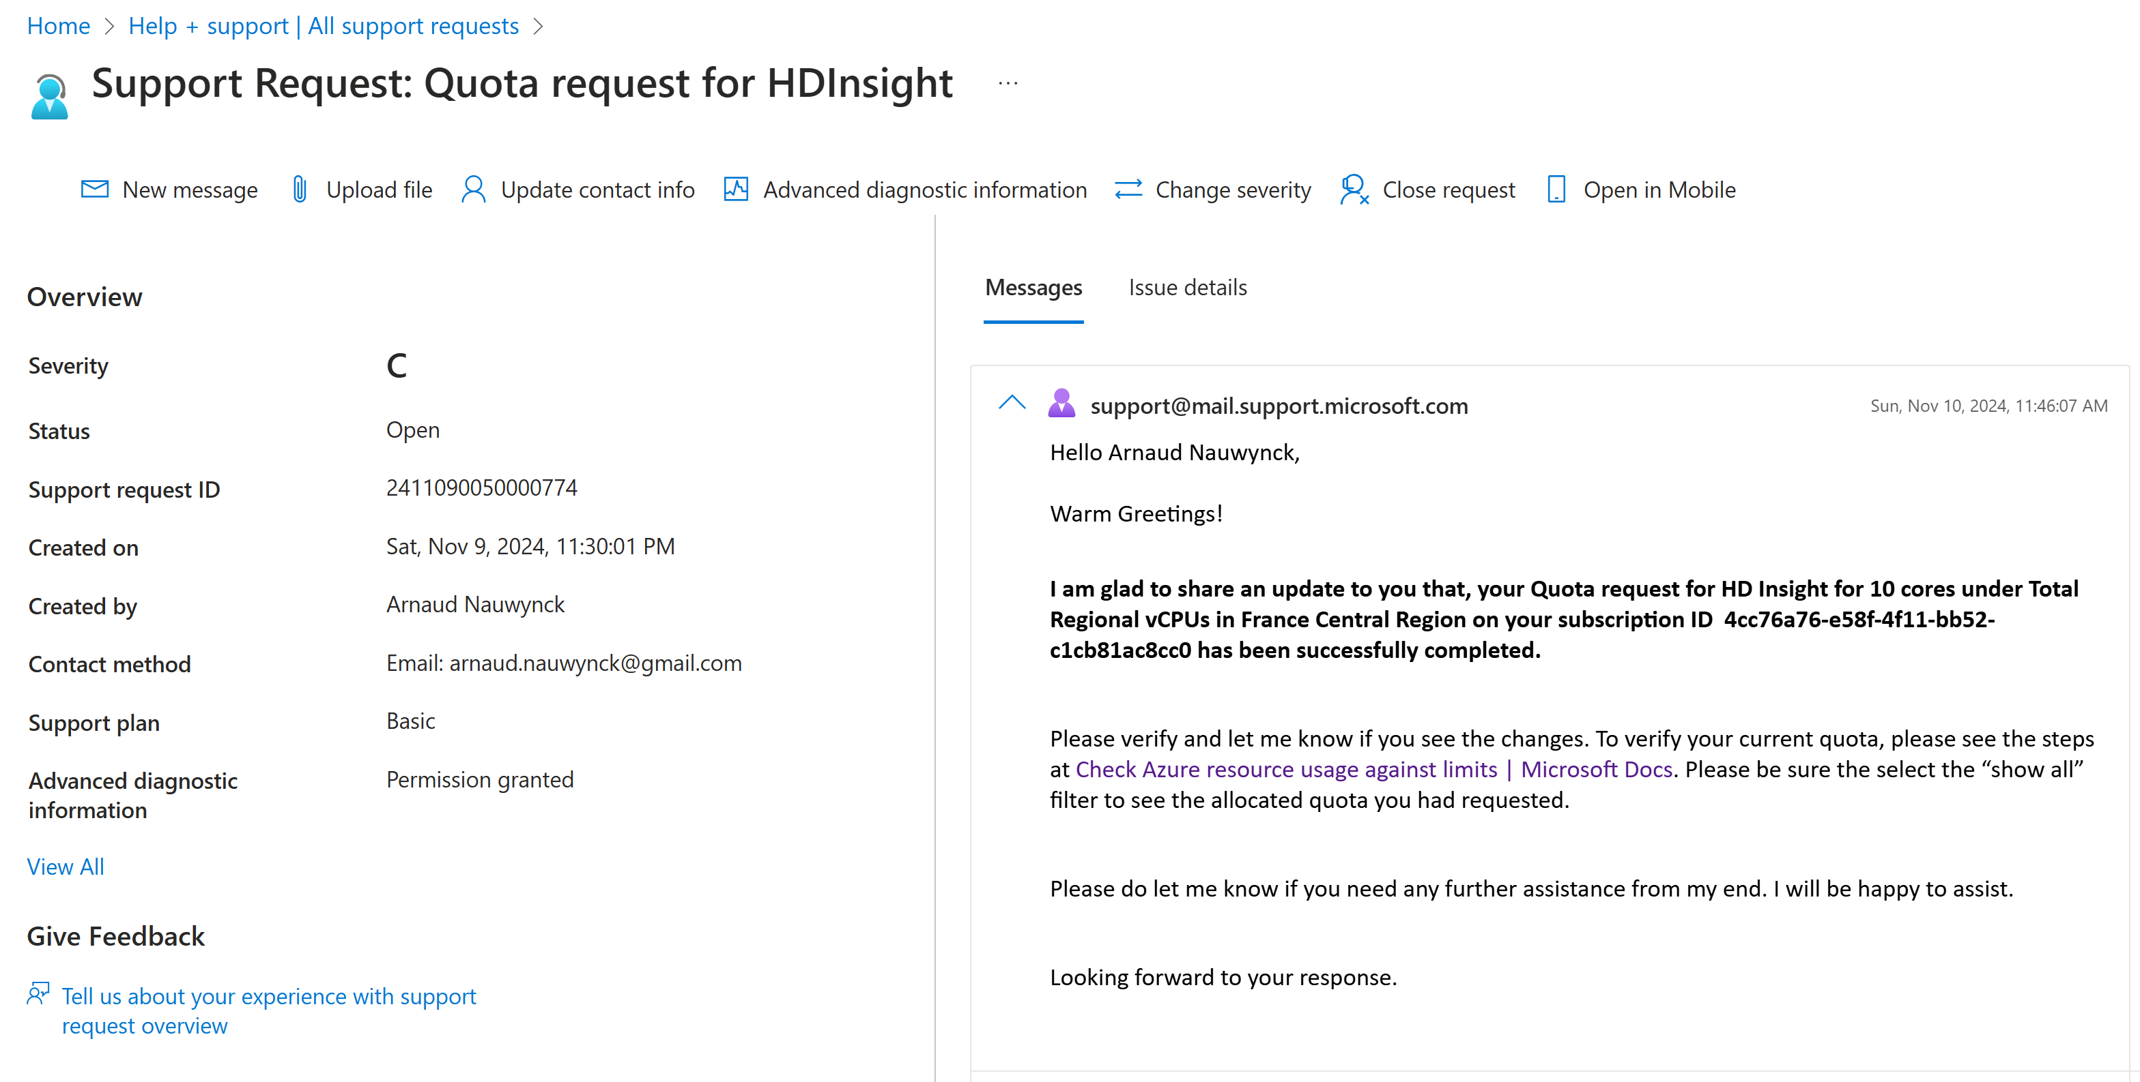
Support Request Answer: Quota Increased

Slide 30
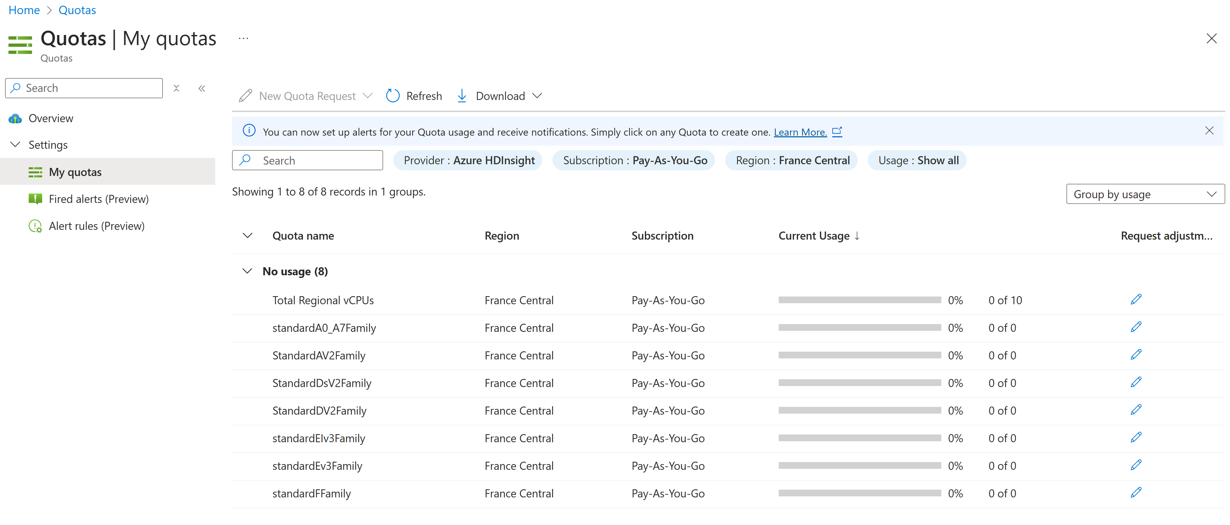
Quota ...

Slide 31
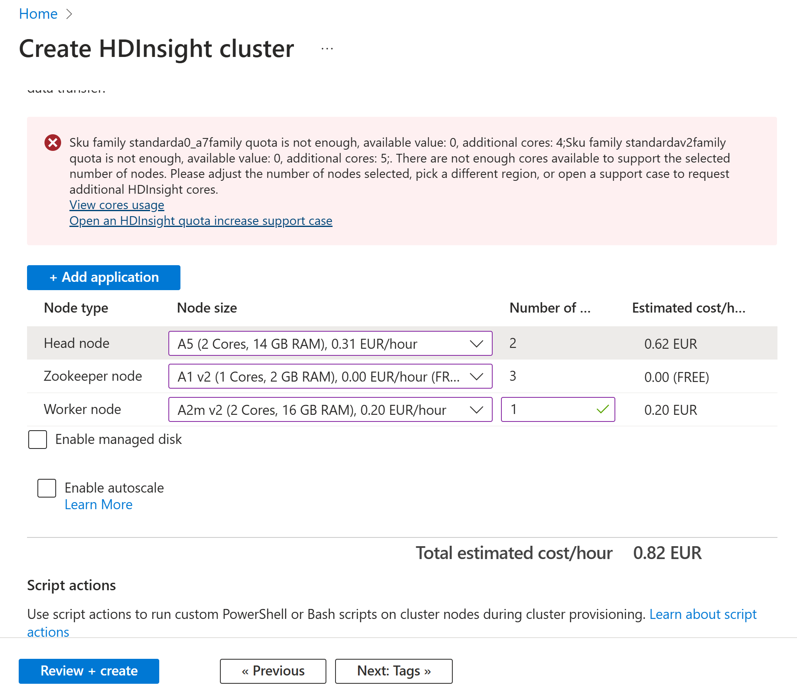
Create Cluster: 2xA5 + 3xA1+ 1xA2

Slide 32
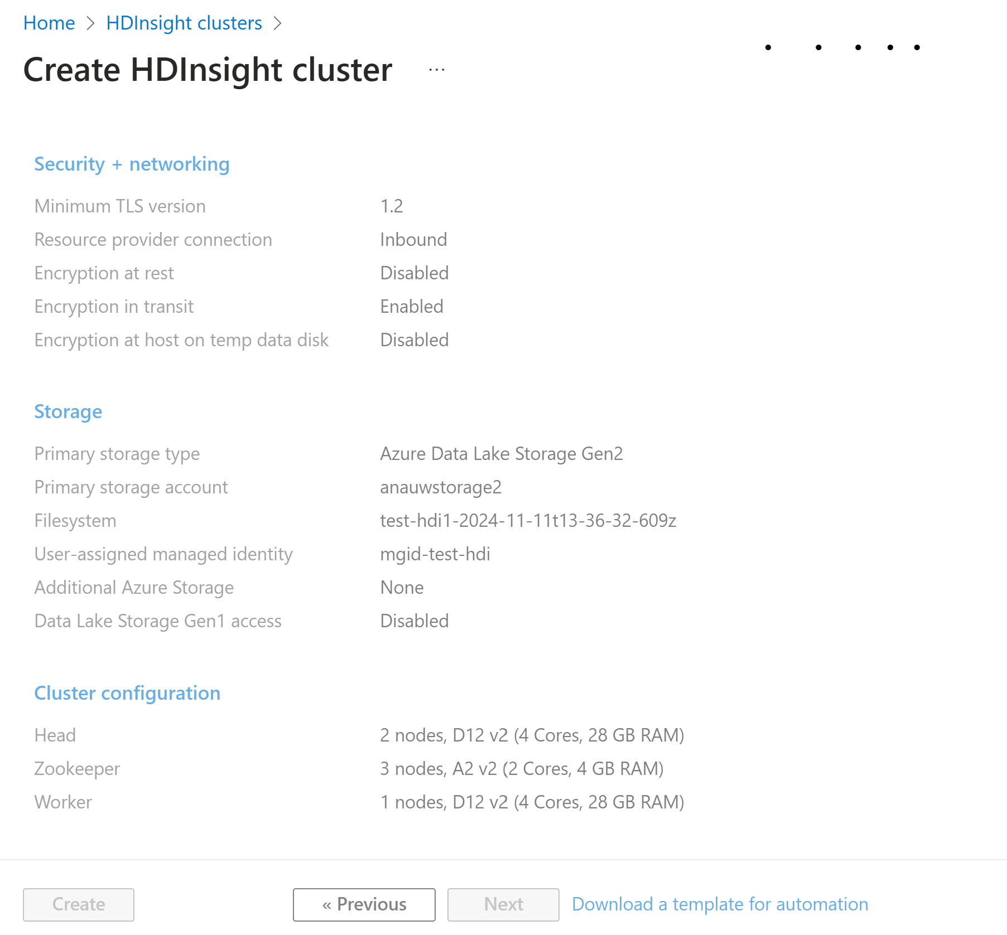
Create HDI ...

Slide 33
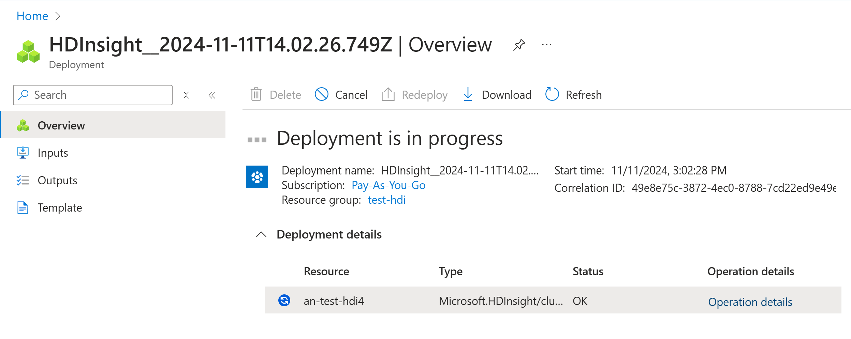
"Deployment" object, in progress

Slide 34
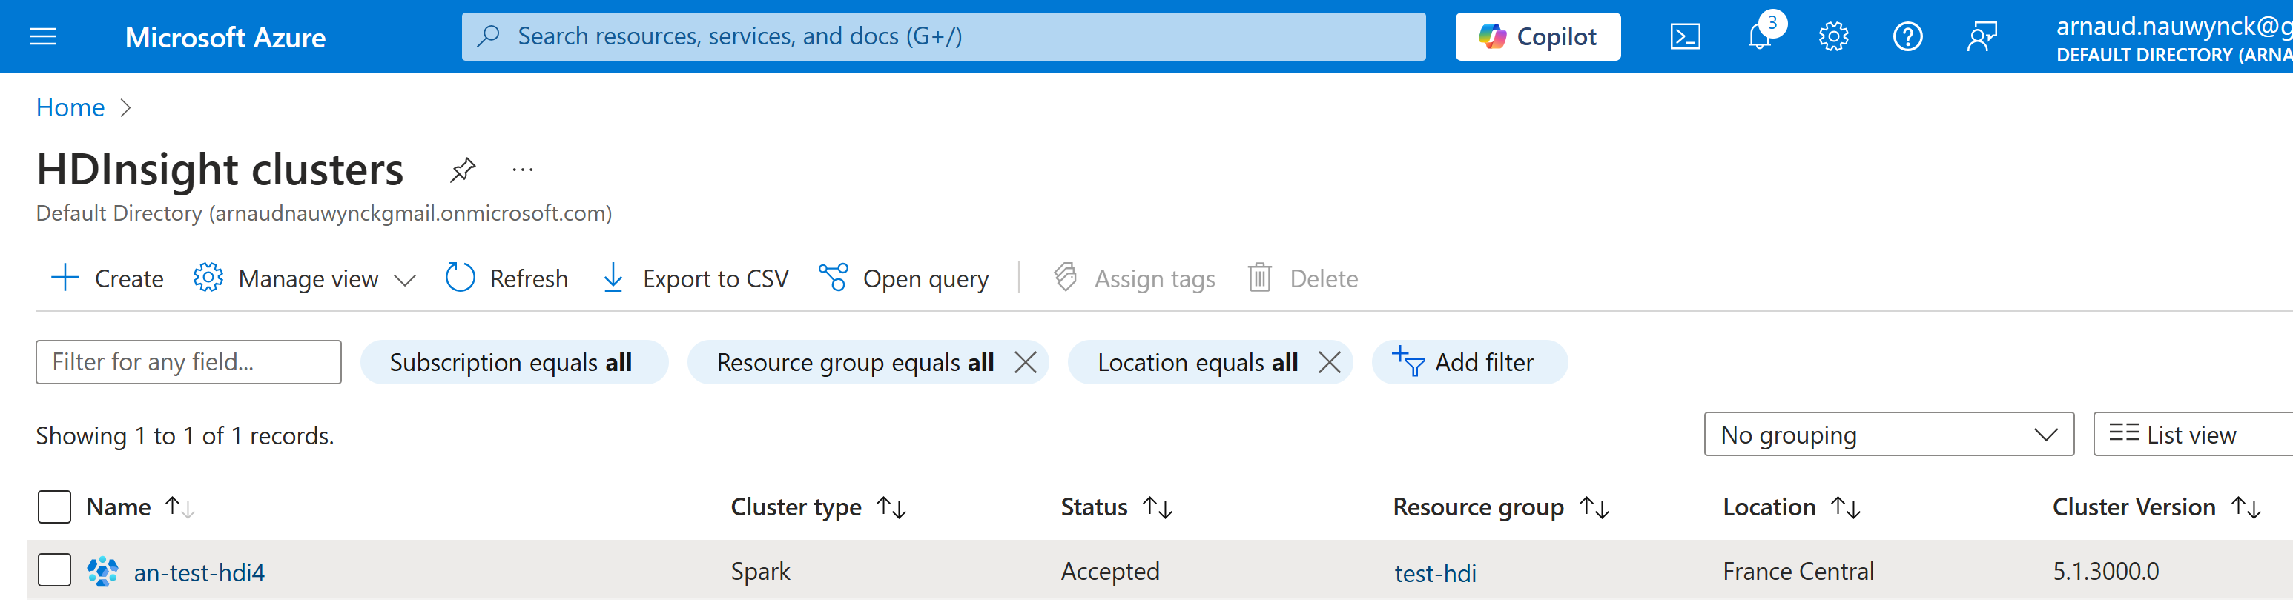
HDInsight Resource, Status=Accepted (!= Running)

Slide 35
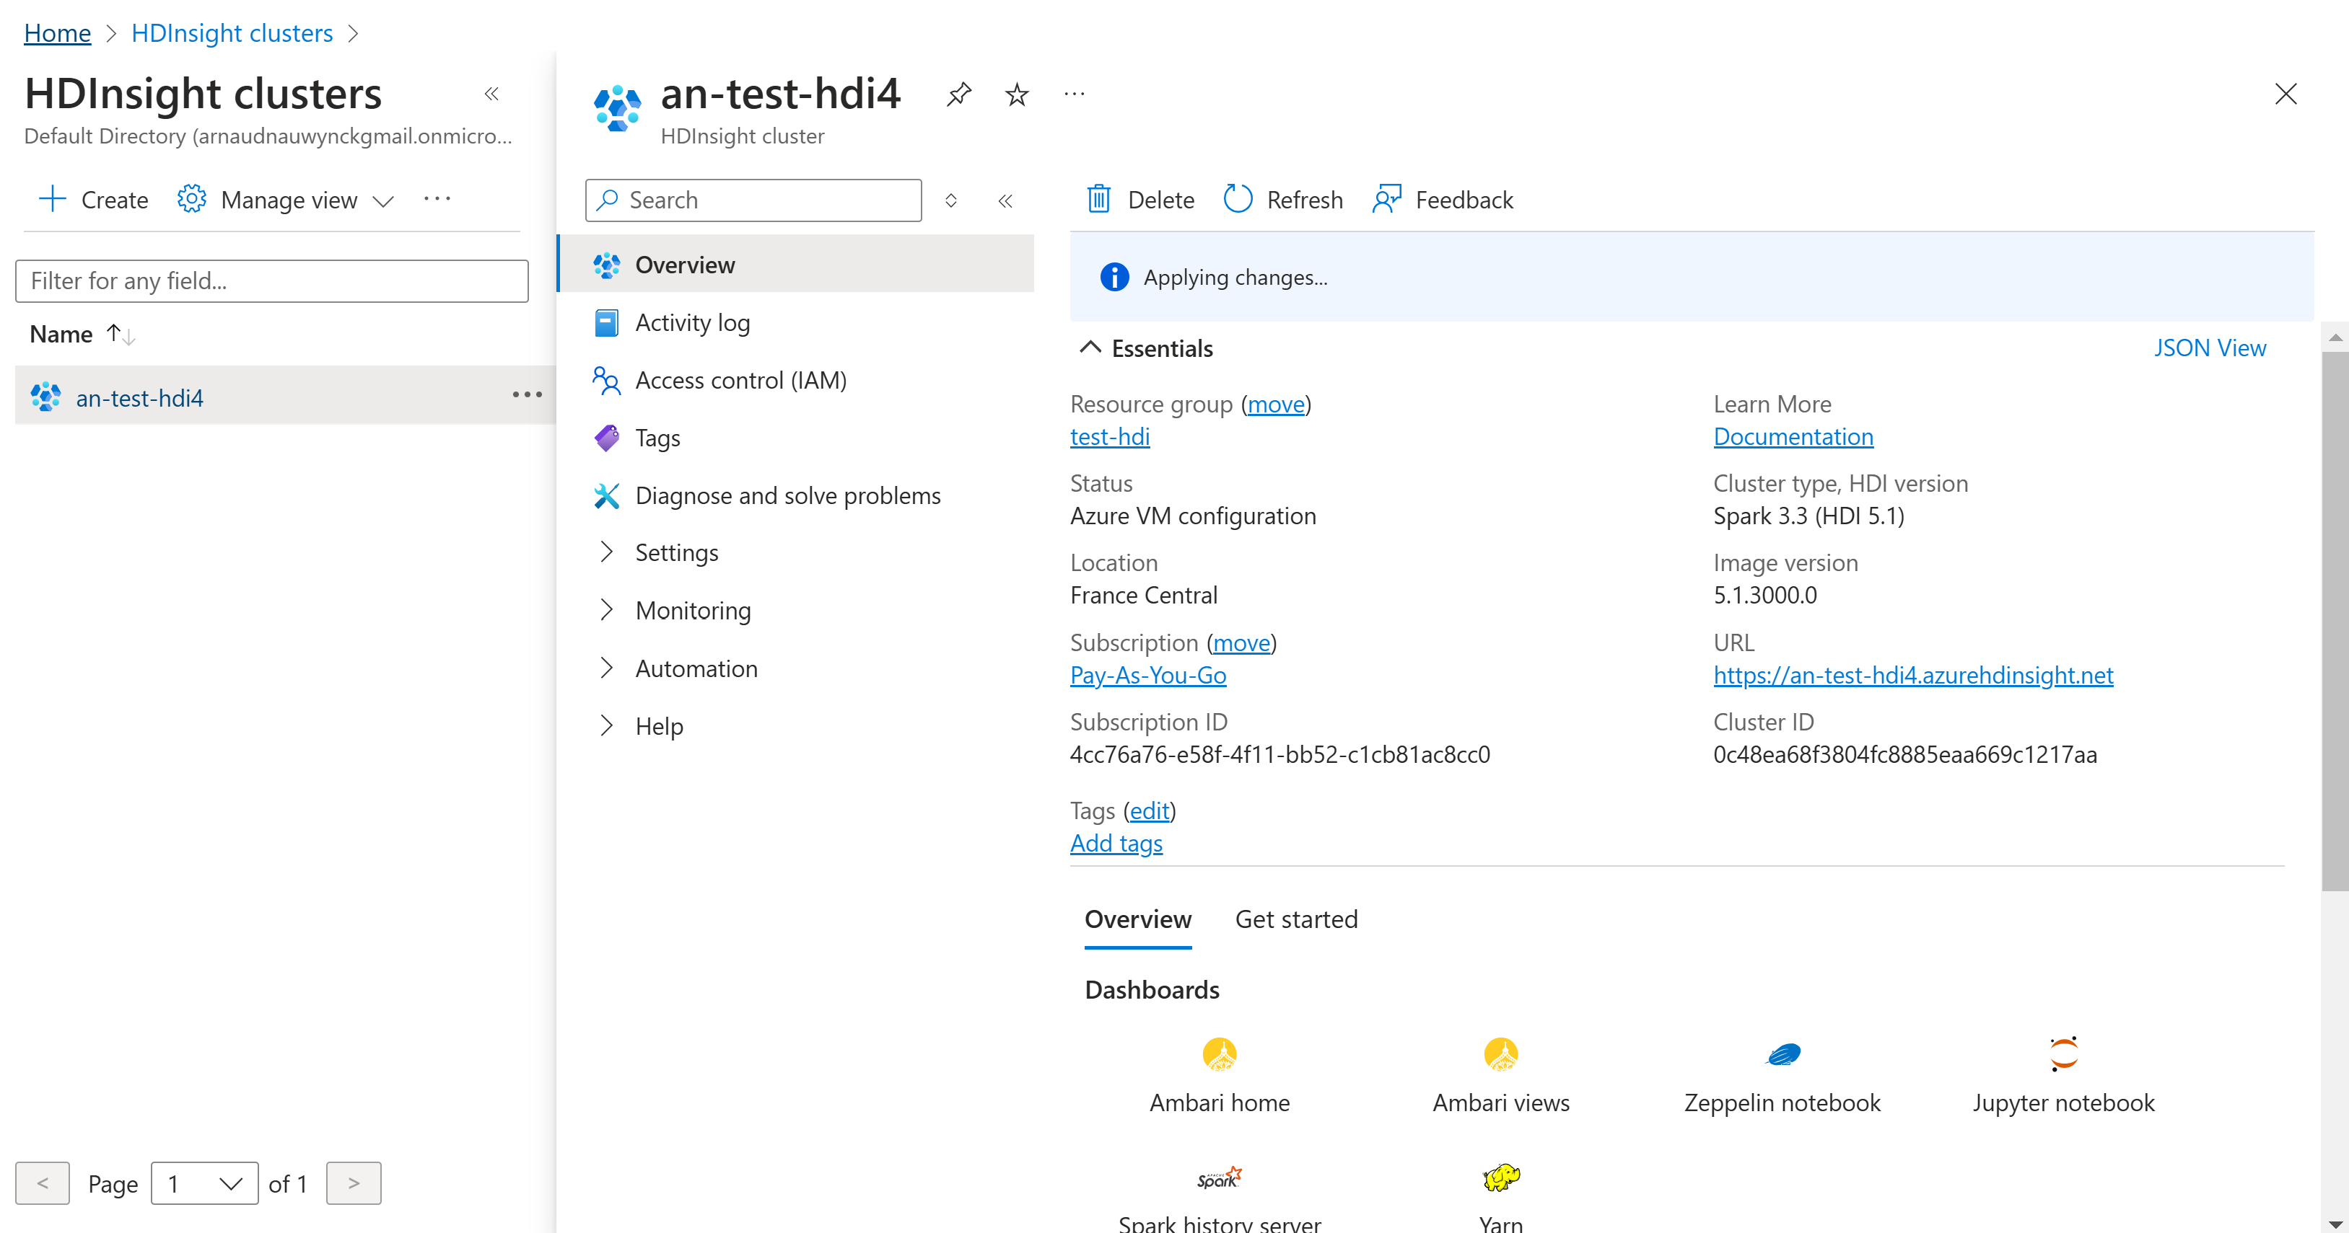
HDInsight - Resource Overview

Slide 36
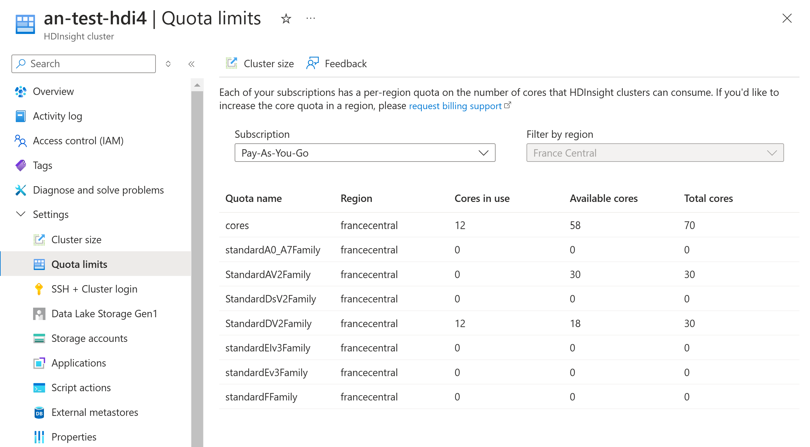
HDInsight - Quota "Core in use"

Slide 37
Using HDI .. Discovering the UI

Slide 38
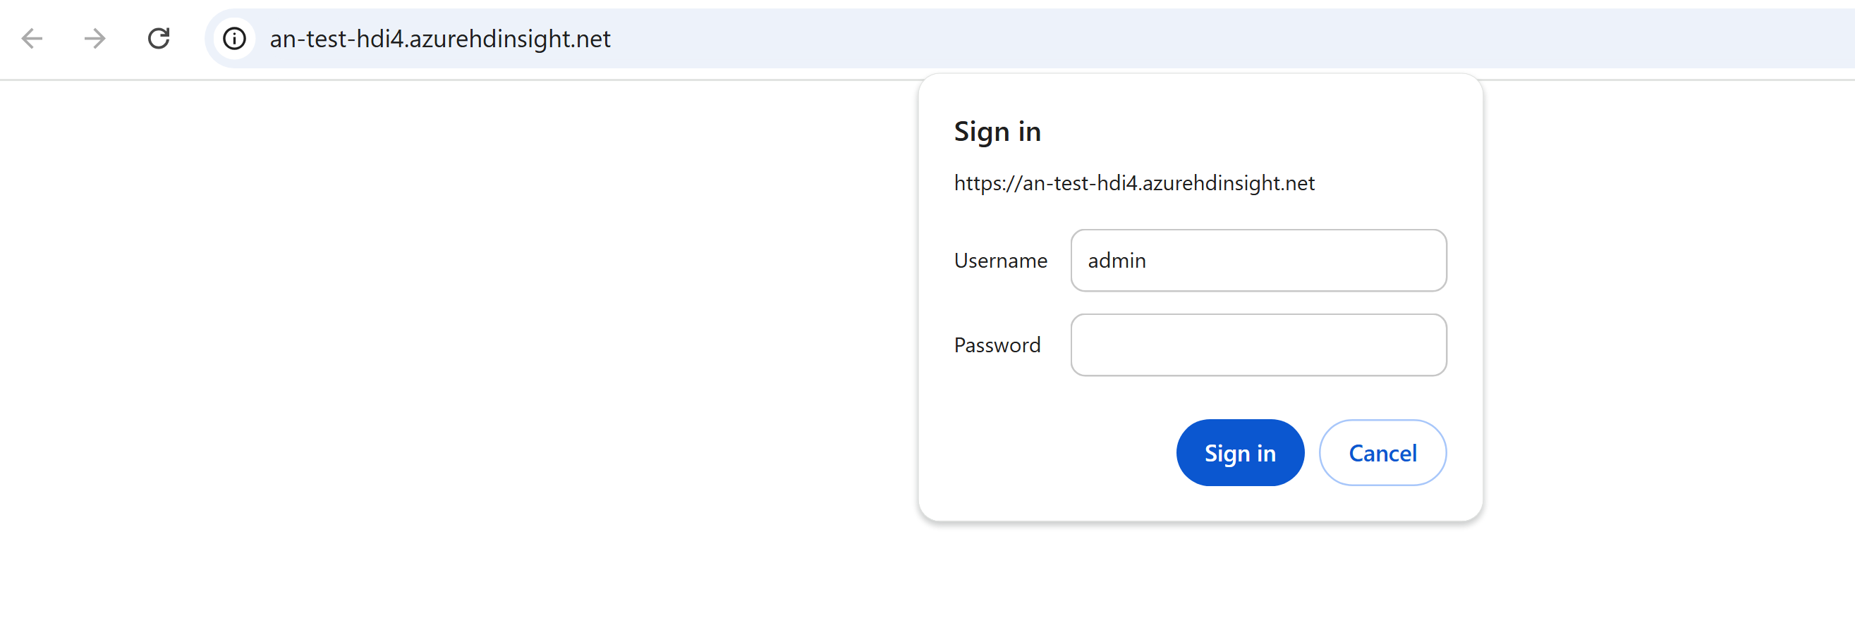
login Http Gateway (=Ambari)

Slide 39
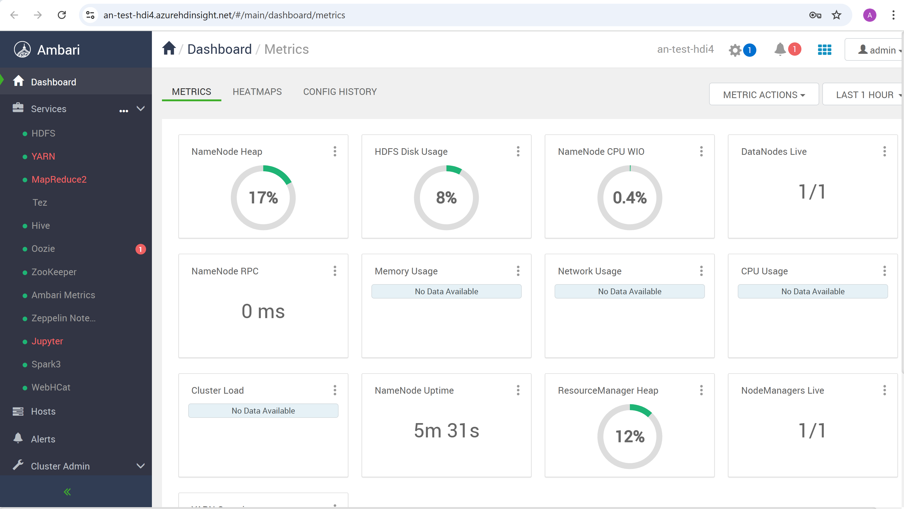
Still in progress => Ambari Alerts

Slide 40
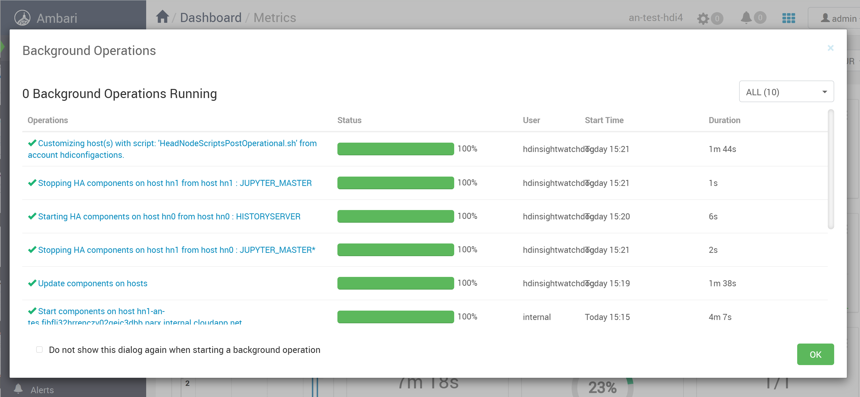
Ambari Scripts

Slide 41
Exploring Ambari Services ...

Slide 42
Ambari > HDFS

Slide 43
Reminder ... No classical "HDFS" on HD-Insight ! => using Azure Storage (AdlsGen2) + Adapter class for Hadoop "VirtualFileSystem"

Slide 44
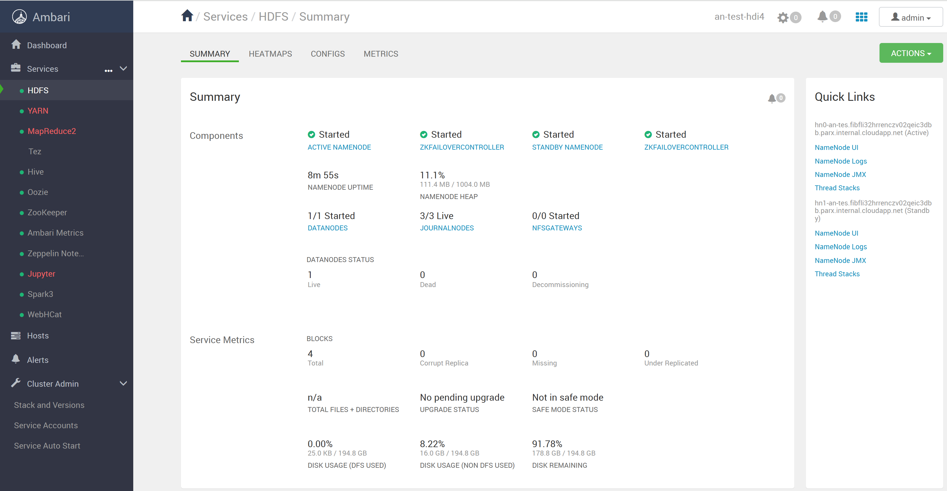
Ambari > Services > HDFS

Slide 45
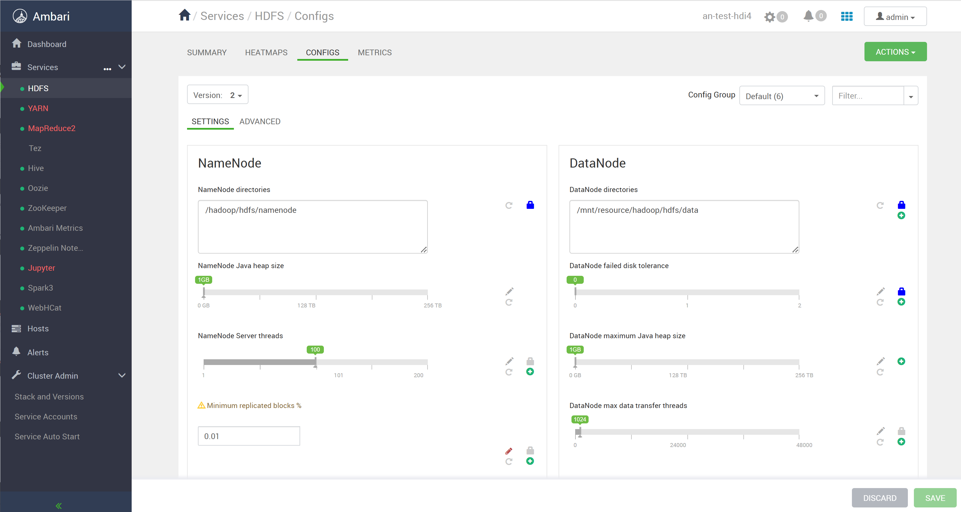
Ambari > HDFS > Configs

Slide 46
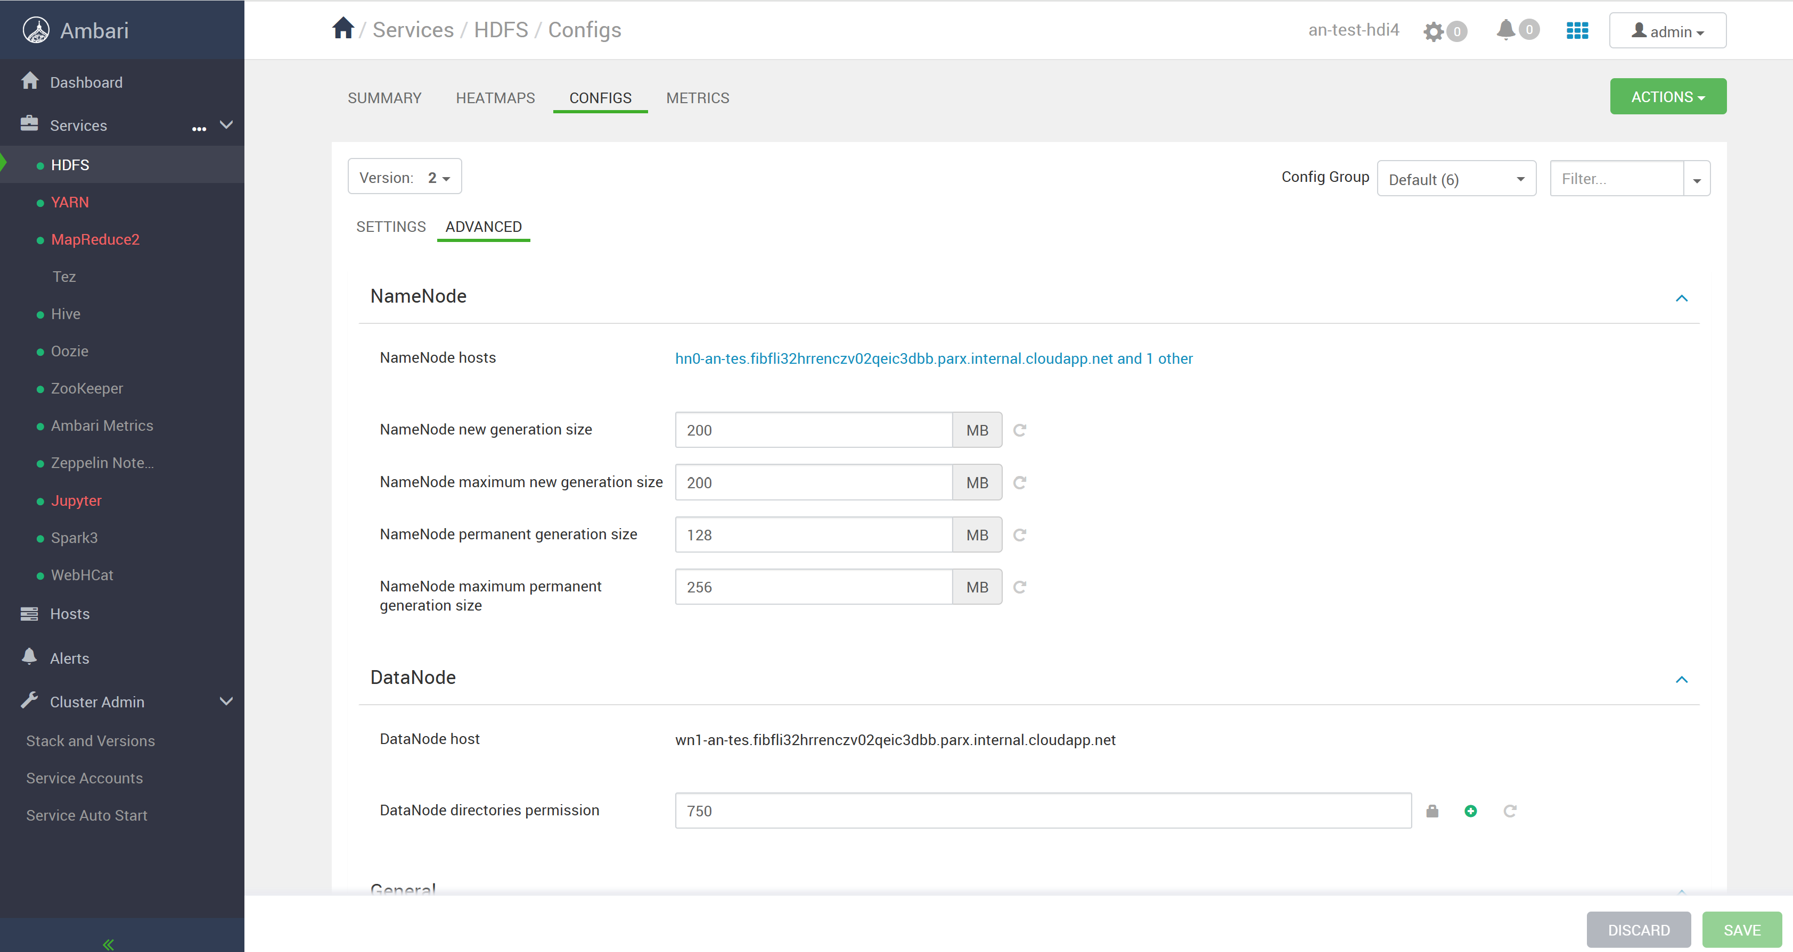
Ambari > HDFS > Configs > Advanced

Slide 47
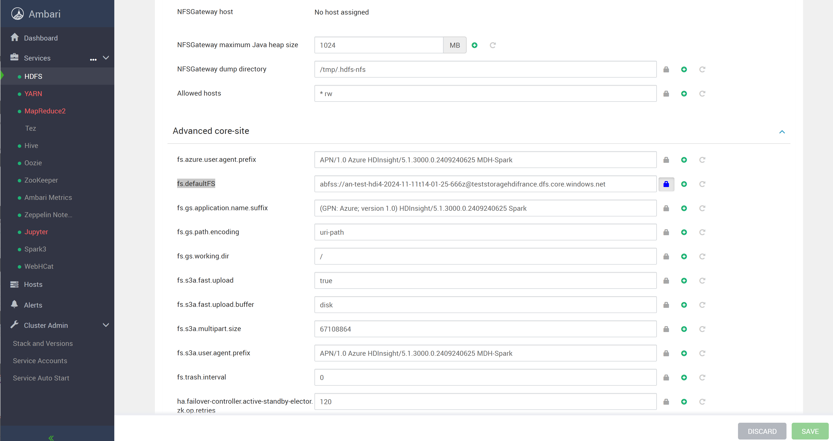
Ambari > HDFS > Configs > Advanced fs.defaultFS in core-site.xml

Slide 48
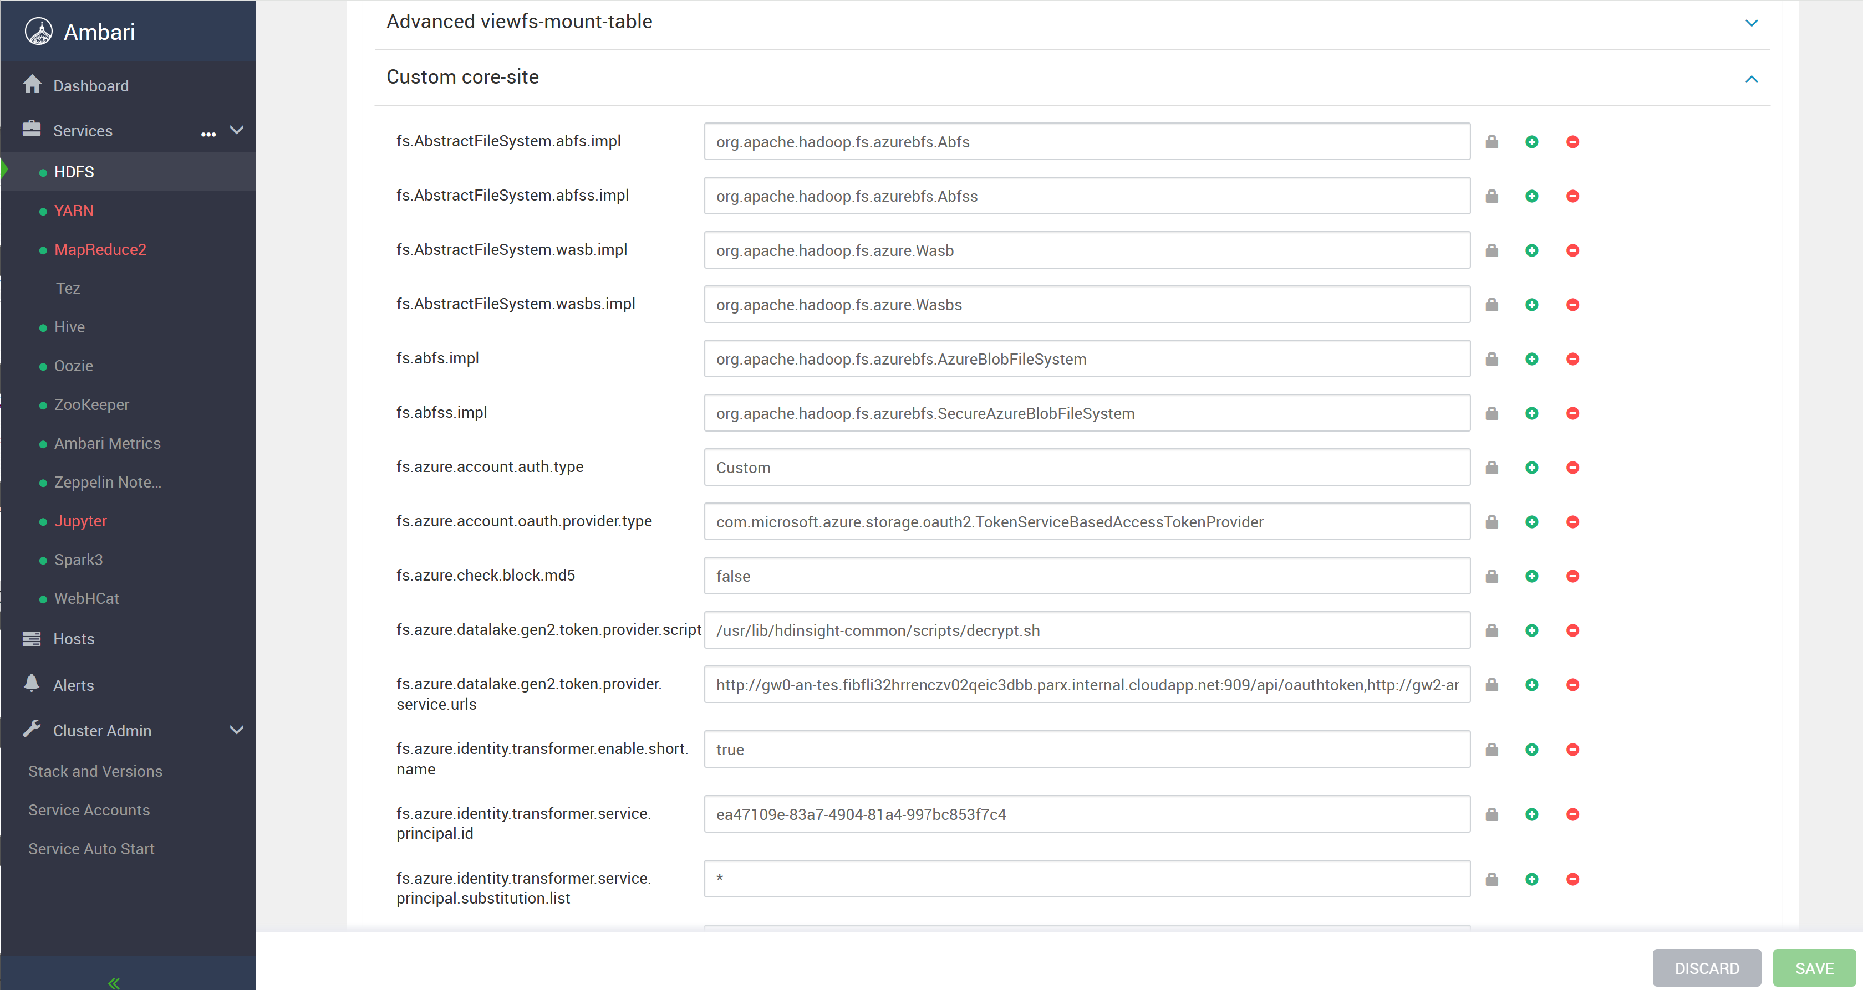
Ambari > HDFS > Configs > Advanced custom hdfs-site.xml
Hook for support Azure Storage AdlsGen2 (abfs://...)
in Hadoop

Slide 49
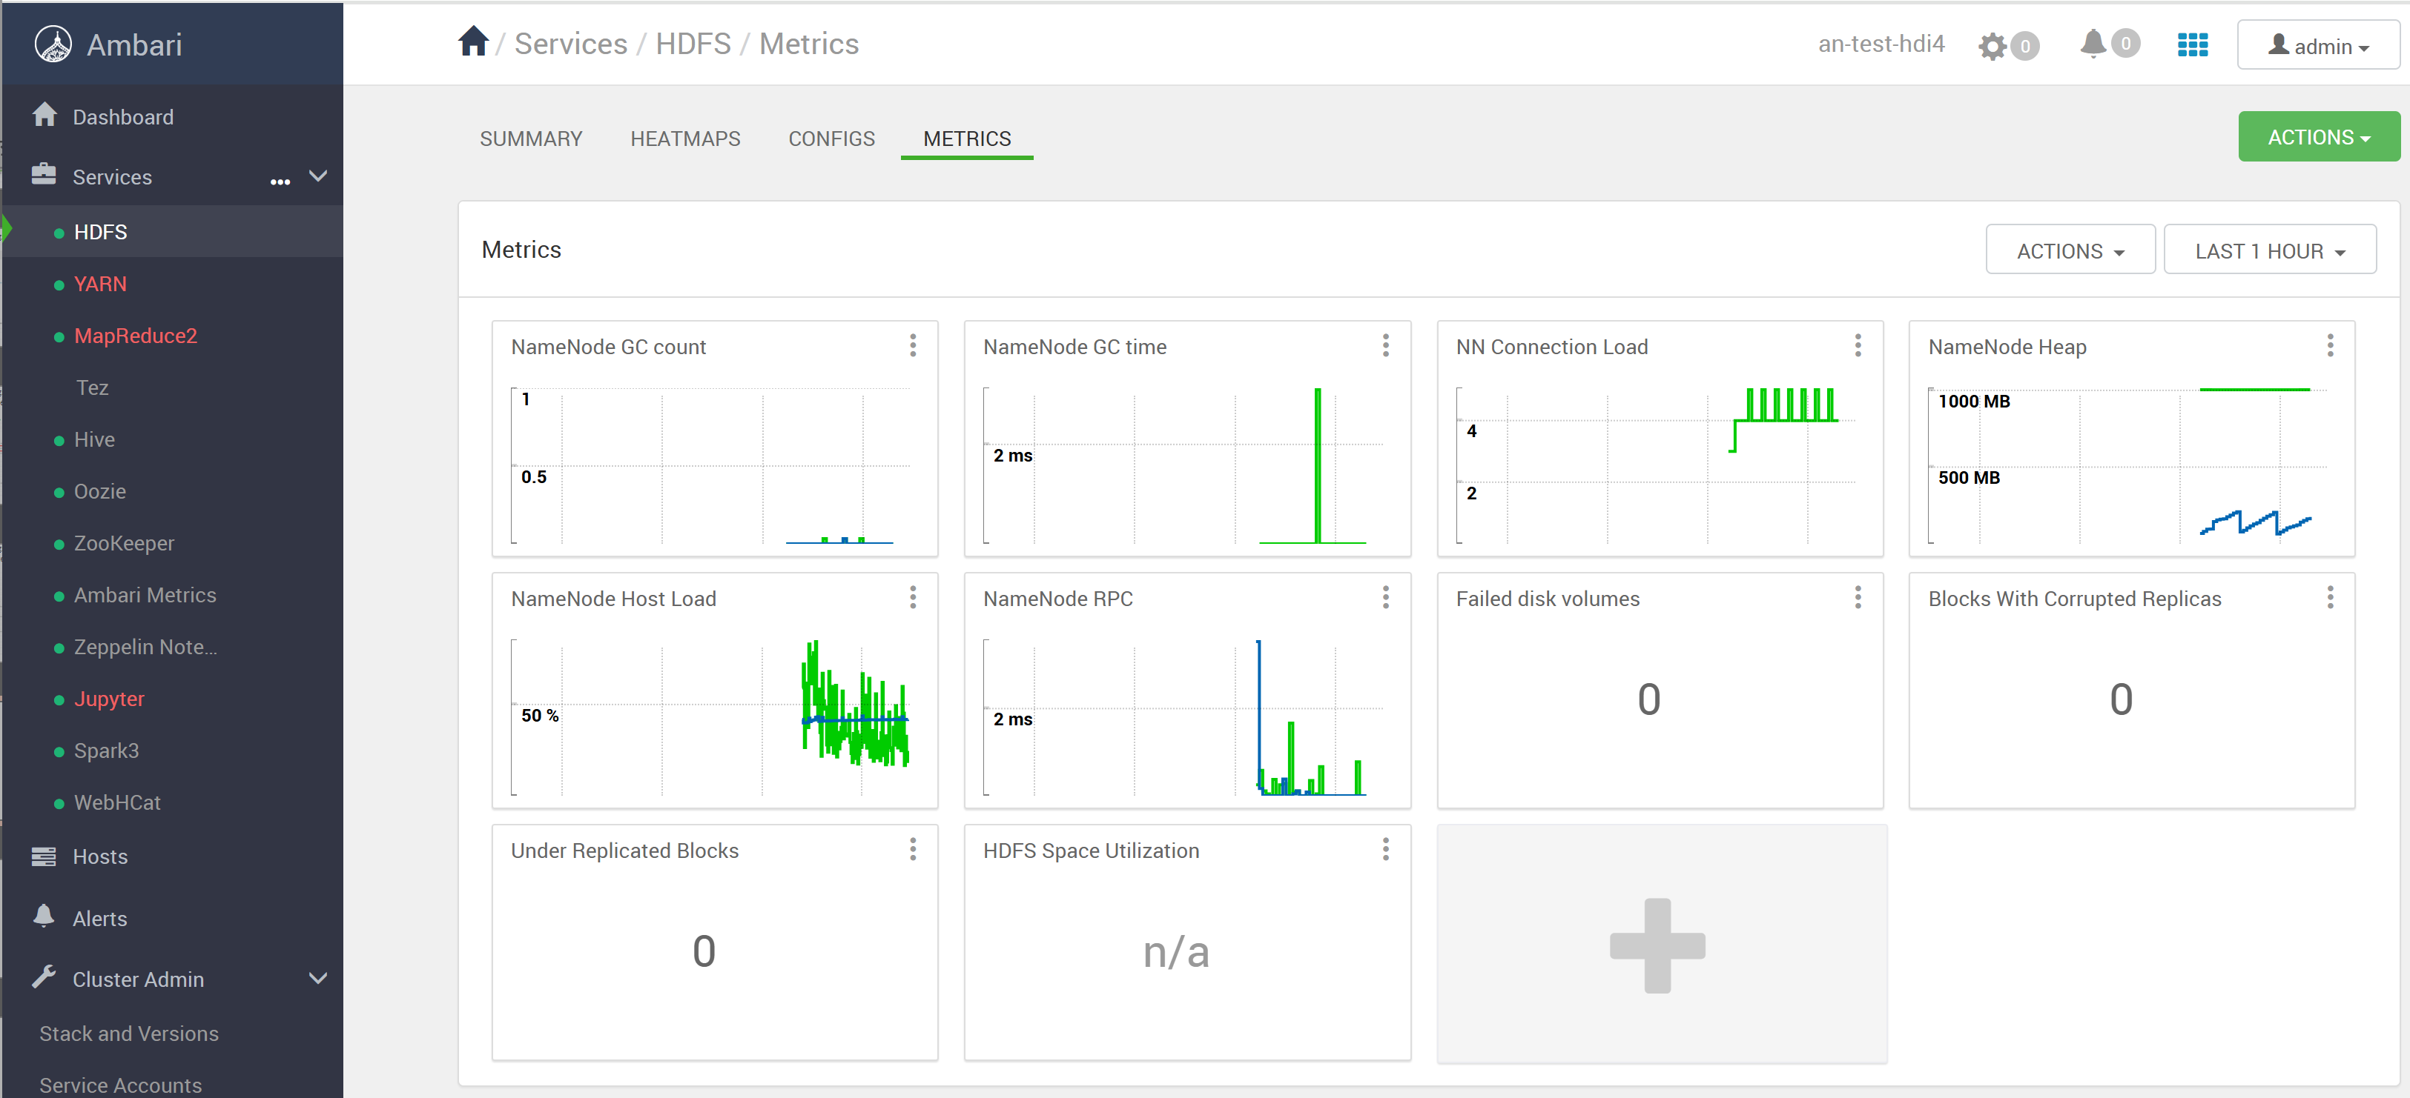
Ambari > HDFS > Metrics

Slide 50
Ambari > Yarn

Slide 51
Reminder Yarn Architecture
HeadNode 0
Yarn
ResourceManager
WorkerNode wn0
wn1
wn2
Yarn
NodeManager
wn3
Http Gateway
+ TimeLineServer
wn10
schedule App (Container)
Creation
HeadNode 1
Http/RPC requests
Yarn
ResourceManager
redirect requests
to active
(/ standby)
Launch Container
+ watch logs/end
+ TimeLineServer
Yarn Database

Slide 52
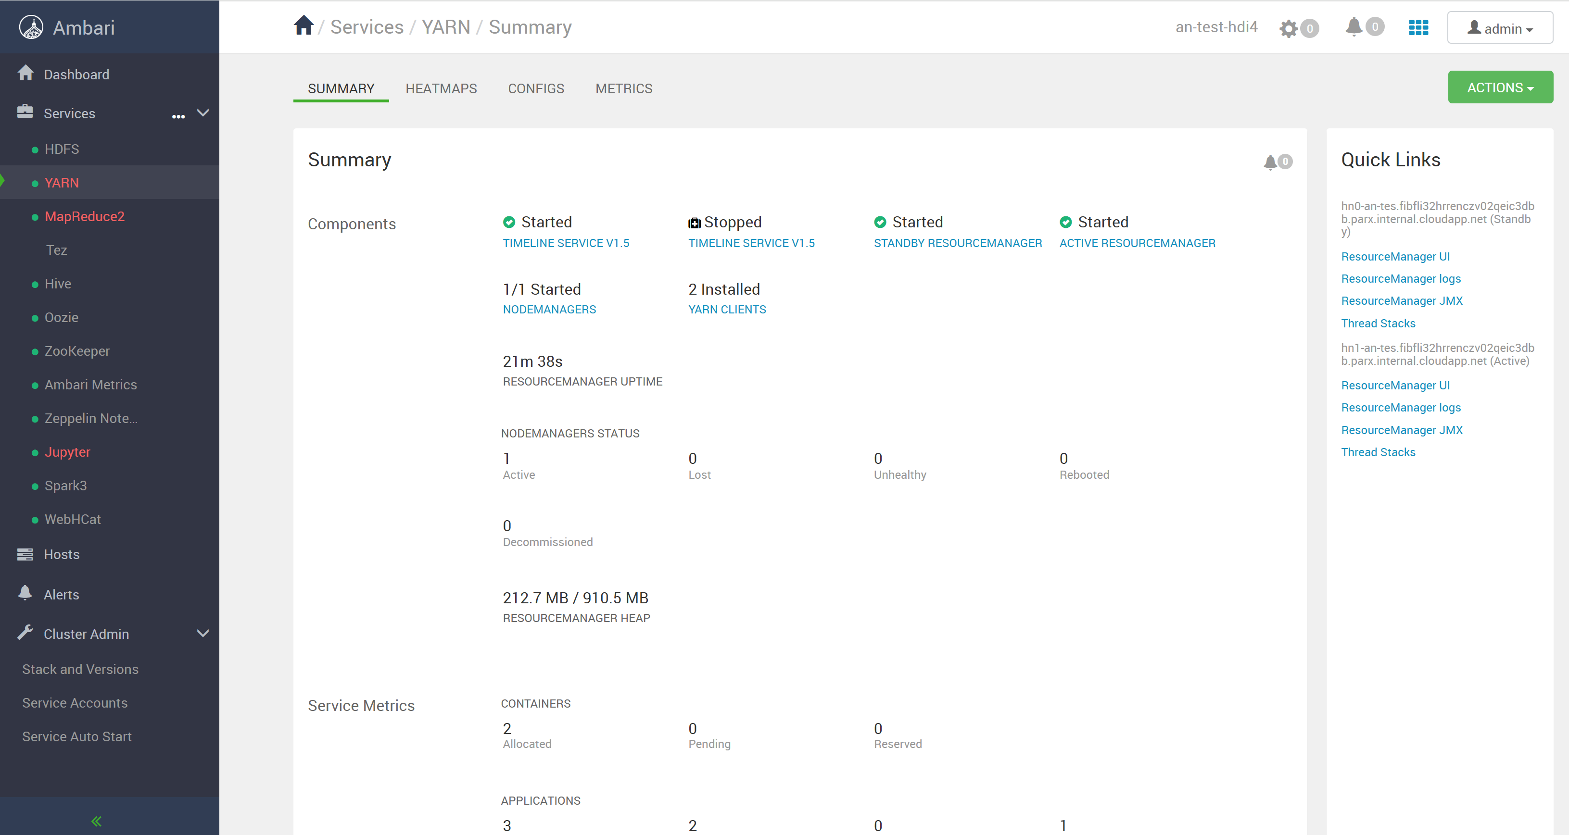
Ambari > Yarn > Summary

Slide 53
Click on Quick Links "Resource Manager UI"

Slide 54
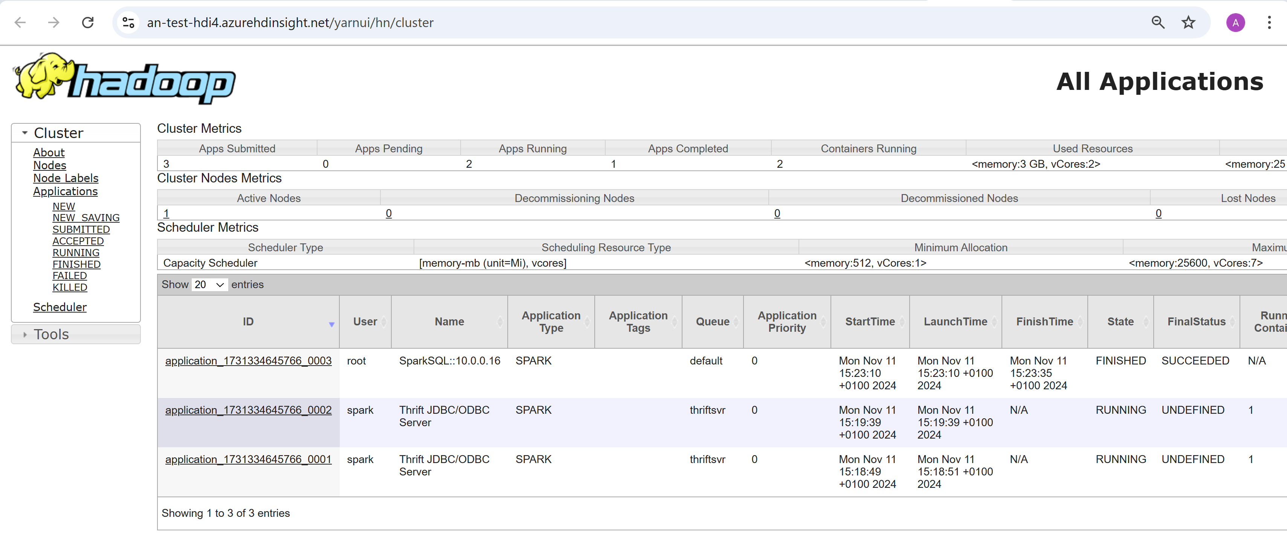
<<baseurl>> /yarnui (=Webapp for Yarn ResourceManager)

Slide 55
Click on 1 Application (Stil Running OR Finished)

Slide 56
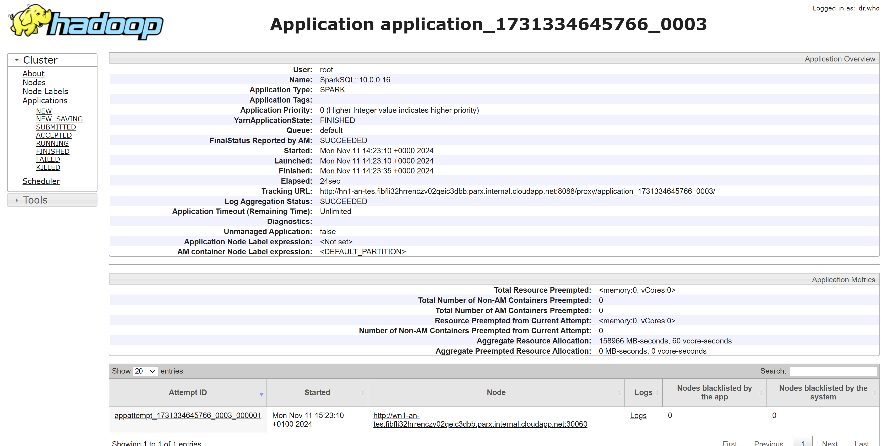
/yarnui/hn/cluster/app/application_<<id>>
example: a FINISHED Spark Application

Slide 57
Yarn Application Internals : Attempt -> (AM) Master -> Containers
Admitedly : Yarn is over complex ... Think analogies with Kubernetes
Attempt => first try to launch, then maybe retries on failure
AM Master => idem "K8s Operator", but restricted to 1 Application
Container => mostly java apps (Docker images also supported after)

Slide 58
Click on Application > Attempt "appattempt_<<id>>_000001"

Slide 59
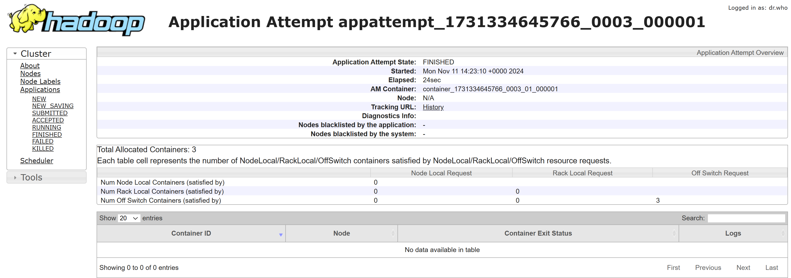
Application Attempt

Slide 60
Aplication Attempt (finished) => click on "History"

Slide 61
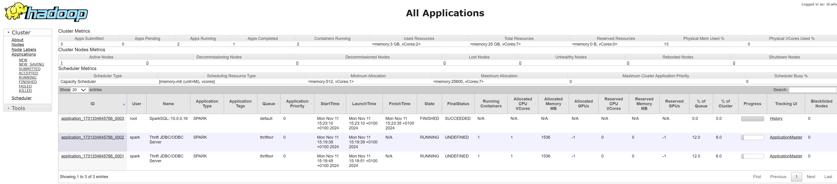
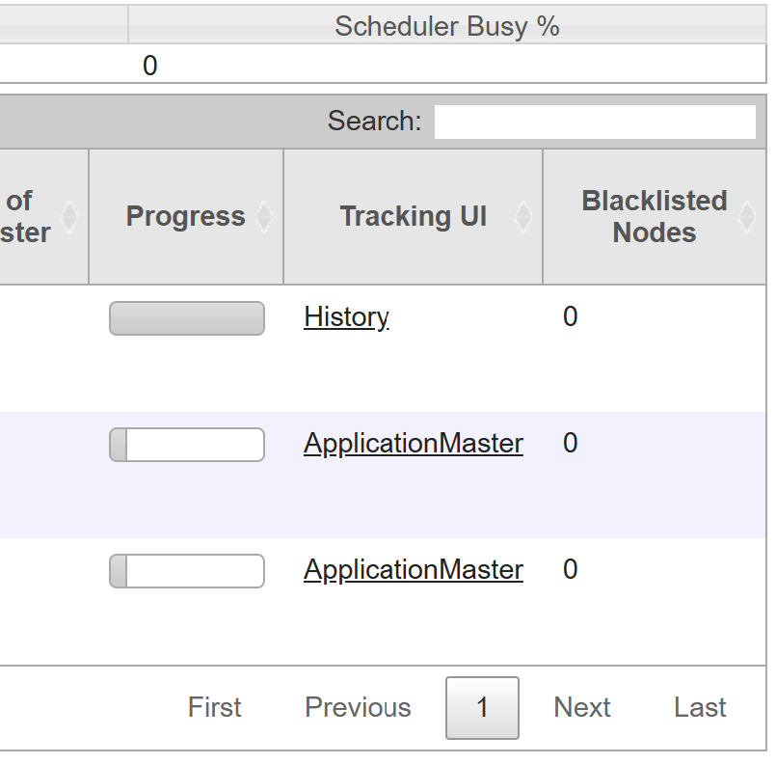
equivalent Direct Link via "Tracking UI" column

Slide 62

Application History... for type Spark = SparkUI url: /sparkhistory/application_<<id>>

Slide 63
Click on Application > Attempt > "logs"

Slide 64

Yarn logs

Slide 65

logs ... summary "stdout", "stderr"

Slide 66

Click on stderr details "here"

Slide 67

Using "Save As..." instead of click "here" for untruncated (10 Mega?)

Slide 68
Cilck on Application > Attempt > "node"

Slide 69

Yarn NodeManager "wn1"

Slide 70

click on "Scheduler"

Slide 71

Yarn Scheduler Queue

Slide 72

(Admin) Edit Yarn Queue

Slide 73

filter "FINISHED" Applications

Slide 74

filter "RUNNING" Applications

Slide 75

click a RUNNING Yarn Application

Slide 76

RUNNING Application > Attempt

Slide 77

when Applications are still running => "/proxy" redirect to real process instead of "History" server url: /yarnui/hn/proxy/application_<<id>>

Slide 78

RUNNING Application > AM Master > Container

Slide 79

Container > logs

Slide 80

UI Experience for browsing Log in Yarn ... ( and not Search by Text or Regexp, no selection by Time Range ... nothing)

Slide 81
Ambari > Oozie

Slide 82

Ambari > Oozie > Summary

Slide 83
Ambari > Oozie > Quick Link "Oozie Web UI"

Slide 84

Oozie UI

Slide 85
Oozie .. no job launched yet, need "workflow.xml" file + submit (not from UI !)

Slide 86
Ambari > Spark

Slide 87

Ambari > Spark > Summary

Slide 88
Ambari > Spark > Quick Link > "Spark History Server UI"

Slide 89

Spark History Server url : /sparkhistory

Slide 90

Click on SparkHistory > Application => see Spark UI (same URL as Tracker URL from Yarn)

Slide 91
Spark History Server Download "eventlog" Files
download "evenlog" File
( keep long,
send by email..)

Slide 92
Spark History Server click "Show Incomplete Applications"

Slide 93

Spark History > Incomplete Applications
Notice: Spark History may discover "eventlog" Files for RUNNING apps, with a delay of ~5 minutes

Slide 94
Ambari > Zeppelin

Slide 95

Ambari > Zeppelin > Summary

Slide 96

Zeppelin url: /zeppelin/#

Slide 97

Zeppelin > New Notebook

Slide 98

Create Zeppelin Notebook (Interpreter=Spark)

Slide 99

Zeppelin > Cell > "Shift-Enter" to execute

Slide 100

Zeppelin -> Spark Job

Slide 101

Zeppelin - Spark Job launched by "local" (not visible in yarnui) or by livy

Slide 102

Zeppelin Spark Job in SparkUI

Slide 103
Jupyter

Slide 104

Jupyter url :/jupyter

Slide 105
Ambari > Hive View (NOT RECOMMENDED, prefer Spark)

Slide 106

Ambari > Hive View 2

Slide 107

Ambari > Hive View (page loading...)

Slide 108

Ambari > Hive View

Slide 109

HiveView > Execute SQL Query

Slide 110
(ADMIN) Ambari > Hosts

Slide 111

Ambari > Hosts (admin)
Hosts : 2 Head Nodes (hn0, hn1) + 3 Zookeeper Nodes (zk0, zk1, zk2) + N (>=1) Worker Nodes (wn0, wn1, ...)

Slide 112

Ambari > Hosts > wn1 Summary

Slide 113
(ADMIN) Ambari > Users & Groups

Slide 114

(ADMIN) Ambari > Login > Manage Amari

Slide 115

Ambari > Admin > Users

Slide 116

Ambari > Admin > Groups

Slide 117
(ADMIN) Ambari > Metrics > Grafana

Slide 118

(ADMIN) Ambari Metrics > Grafana

Slide 119

Grafana

Slide 120
Conclusion
HD Insight is a ready to use all-in-one Hadoop environnement.
Hadoop would be extremely difficult to setup yourself on your PC (ok on linux, not windows).
Hadoop Yarn is overly complex.
Kubernetes is Better than Hadoop Yarn.
And Unfortunatly, there is NO standard "pre-package" all-in-one environment for Spark on k8s + Jupyter + ...
But, with a custom environment,
Spark on Kubernetes is Better/Cheaper/Easier than Spark on HD-Insight.

Slide 121
Questions ? arnaud.nauwynck@gmail.com

